Slide 1
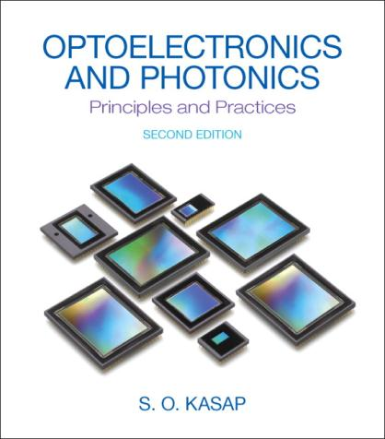
Power Point for Optoelectronics and Photonics: Principles and Practices
Second Edition
A Complete Course in Power Point
Chapter 2
ISBN-10: 0133081753
Second Edition Version 1.05800 [30 March 2016]

Slide 2
Updates and
Corrected Slides
Class Demonstrations
Class Problems
Check author’s website
http://optoelectronics.usask.ca
Email errors and corrections to safa.kasap@yahoo.com

Slide 3
Slides on Selected Topics on Optoelectronics
may be available at the author website
http://optoelectronics.usask.ca
Email errors and corrections to safa.kasap@yahoo.com

Slide 4
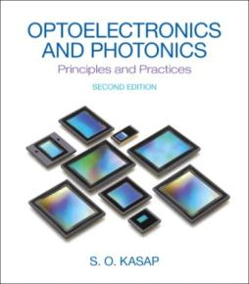
Copyright Information and Permission: Part I
This Power Point presentation is a copyrighted supplemental material to the textbook Optoelectronics and Photonics: Principles & Practices, Second Edition, S. O. Kasap, Pearson Education (USA), ISBN-10: 0132151499, ISBN-13: 9780132151498. © 2013 Pearson Education. Permission is given to instructors to use these Power Point slides in their lectures provided that the above book has been adopted as a primary required textbook for the course. Slides may be used in research seminars at research meetings, symposia and conferences provided that the author, book title, and copyright information are clearly displayed under each figure. It is unlawful to use the slides for teaching if the textbook is not a required primary book for the course. The slides cannot be distributed in any form whatsoever, especially on the internet, without the written permission of Pearson Education.
Please report typos and errors directly to the author: safa.kasap@yahoo.com

Slide 5
PEARSON
Copyright Information and Permission: Part II
This Power Point presentation is a copyrighted supplemental material to the textbook Optoelectronics and Photonics: Principles & Practices, Second Edition, S. O. Kasap, Pearson Education (USA), ISBN-10: 0132151499, ISBN-13: 9780132151498. © 2013 Pearson Education. The slides cannot be distributed in any form whatsoever, electronically or in print form, without the written permission of Pearson Education. It is unlawful to post these slides, or part of a slide or slides, on the internet.
Copyright © 2013, 2001 by Pearson Education, Inc., Upper Saddle River, New Jersey, 07458. All rights reserved. Printed in the United States of America. This publication is protected by Copyright and permission should be obtained from the publisher prior to any prohibited reproduction, storage in a retrieval system, or transmission in any form or by any means, electronic, mechanical, photocopying, recording, or likewise. For information regarding permission(s), write to: Rights and Permissions Department.

Slide 6
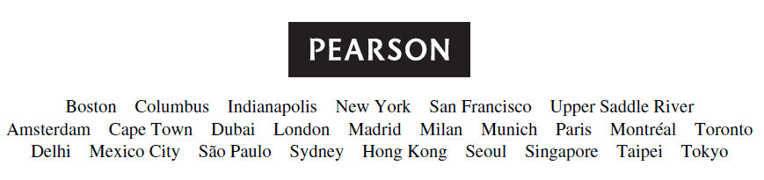
Important Note
You may use color illustrations from this Power Point in your research-related seminars or research-related presentations at scientific or technical meetings, symposia or conferences provided that you fully cite the following reference under each figure
From: S.O. Kasap, Optoelectronics and Photonics: Principles and Practices, Second Edition, © 2013 Pearson Education, USA

Slide 7

Chapter 2 Dielectric Waveguides and Optical Fibers
Charles Kao, Nobel Laureate (2009)
Courtesy of the Chinese University of Hong Kong

Slide 8
Dielectric Waveguides and Optical Fibers
“The introduction of optical fiber systems will revolutionize the communications network. The low-transmission loss and the large bandwidth capability of the fiber systems allow signals to be transmitted for establishing communications contacts over large distances with few or no provisions of intermediate amplification.”
[Charles K. Kao (one of the pioneers of glass fibers for optical communications) Optical Fiber Systems: Technology, Design, and Applications (McGraw-Hill Book Company, New York, USA, 1982), p. 1]
Charles Kao at the naming ceremony of Minor Planet (3463) "Kaokuen" by Nanjing's Purple Mountain Observatory in July 1996. Charles Kao and his colleagues carried out the early experiments on optical fibers at the Standard Telecommunications Laboratories Ltd (the research center of Standard Telephones and Cables) at Harlow in the United Kingdom, during the 1960s. He shared the Nobel Prize in 2009 in Physics with Willard Boyle and George Smith for "groundbreaking achievements concerning the transmission of light in fibers for optical communication." In a milestone paper with George Hockam published in the IEE Proceedings in 1966 they predicted that the intrinsic losses of glass optical fibers could be much lower than 20 dB/km, which would allow their use in long distance telecommunications. Today, optical fibers are used not only in telecommunications but also in various other technologies such as instrumentation and sensing. From 1987 to his retirement in 1996, professor Kao was the Vice Chancellor of the Chinese University of Hong Kong.(Courtesy of the Chinese University of Hong Kong.)
Courtesy of the Chinese University of Hong Kong

Slide 9
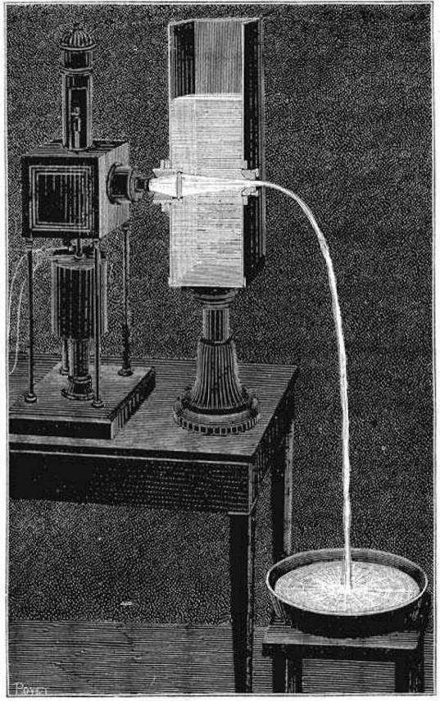
Jean-Daniel Colladon and the Light Guiding in a Water Jet
Light is guided along a water jet as demonstrated by Jean-Daniel Colladon. This illustration was published in La Nature, Revue des Sciences, in 1884 (p. 325). His first demonstration was around 1841. (Comptes Rendes, 15, 800-802, Oct. 24, 1842). A similar demonstration was done by John Tyndall for the Royal Institution in London in his 1854 lecture. Apparently, Michael Faraday had originally suggested the experiment to John Tyndall though Faraday himself probably learned about it either from another earlier demonstration or through Jean-Daniel Colladon's publication. Although John Tyndall is often credited with the original discovery of a water-jet guiding light, Tyndall, himself, does not make that claim but neither does he attribute it to someone else. (The fountain, courtesy of Conservatoire Numérique des Arts et Métiers, France; Colladon's portrait, courtesy of Musée d'histoire des sciences, Genève, Switzerland.)
Reference: Jeff Hecht, "Illuminating the Origin of Light Guiding," Optics & Photonics News, 10, 26, 1999 and his wonderful book The City of Light (Oxford University Press, 2004) describe the evolution of the optical fiber from the water jet experiments of Colladon and Tyndall to modern fibers with historical facts and references.
1841

Slide 10
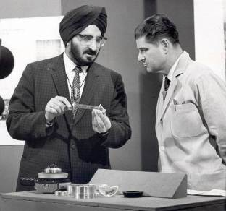
Narinder Singh Kapany
Narinder Singh Kapany was born in Punjab in India, studied at the Agra University and then obtained his PhD from the Imperial College of Science and Technology, University of London in 1955. He held a number of key-positions in both academia and industry, including a Regents Professor at the University of California, Berkeley, the University of California, Santa Cruz (UCSC), the Director of the Center for Innovation and Entrepreneurial Development at UCSC. He made significant contributions to optical glass fibers starting in 1950s, and essentially coined the term fiber optics in the 1960s. His book Fibre Optics: Principles and Applications, published in 1967, was the first in optical fibers. (Courtesy of Dr. Narinder S. Kapany)

Slide 11
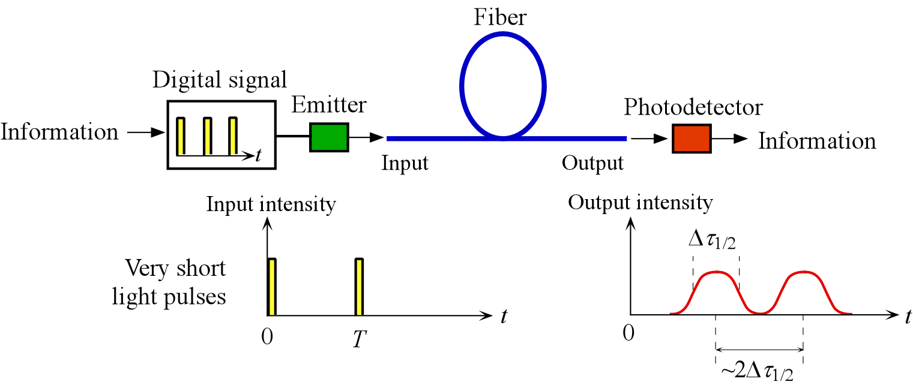
A Century and Half Later
Light has replaced copper in communications. Photons have replaced electrons.
Will “Photonics Engineering” replace Electronics Engineering?

Slide 12
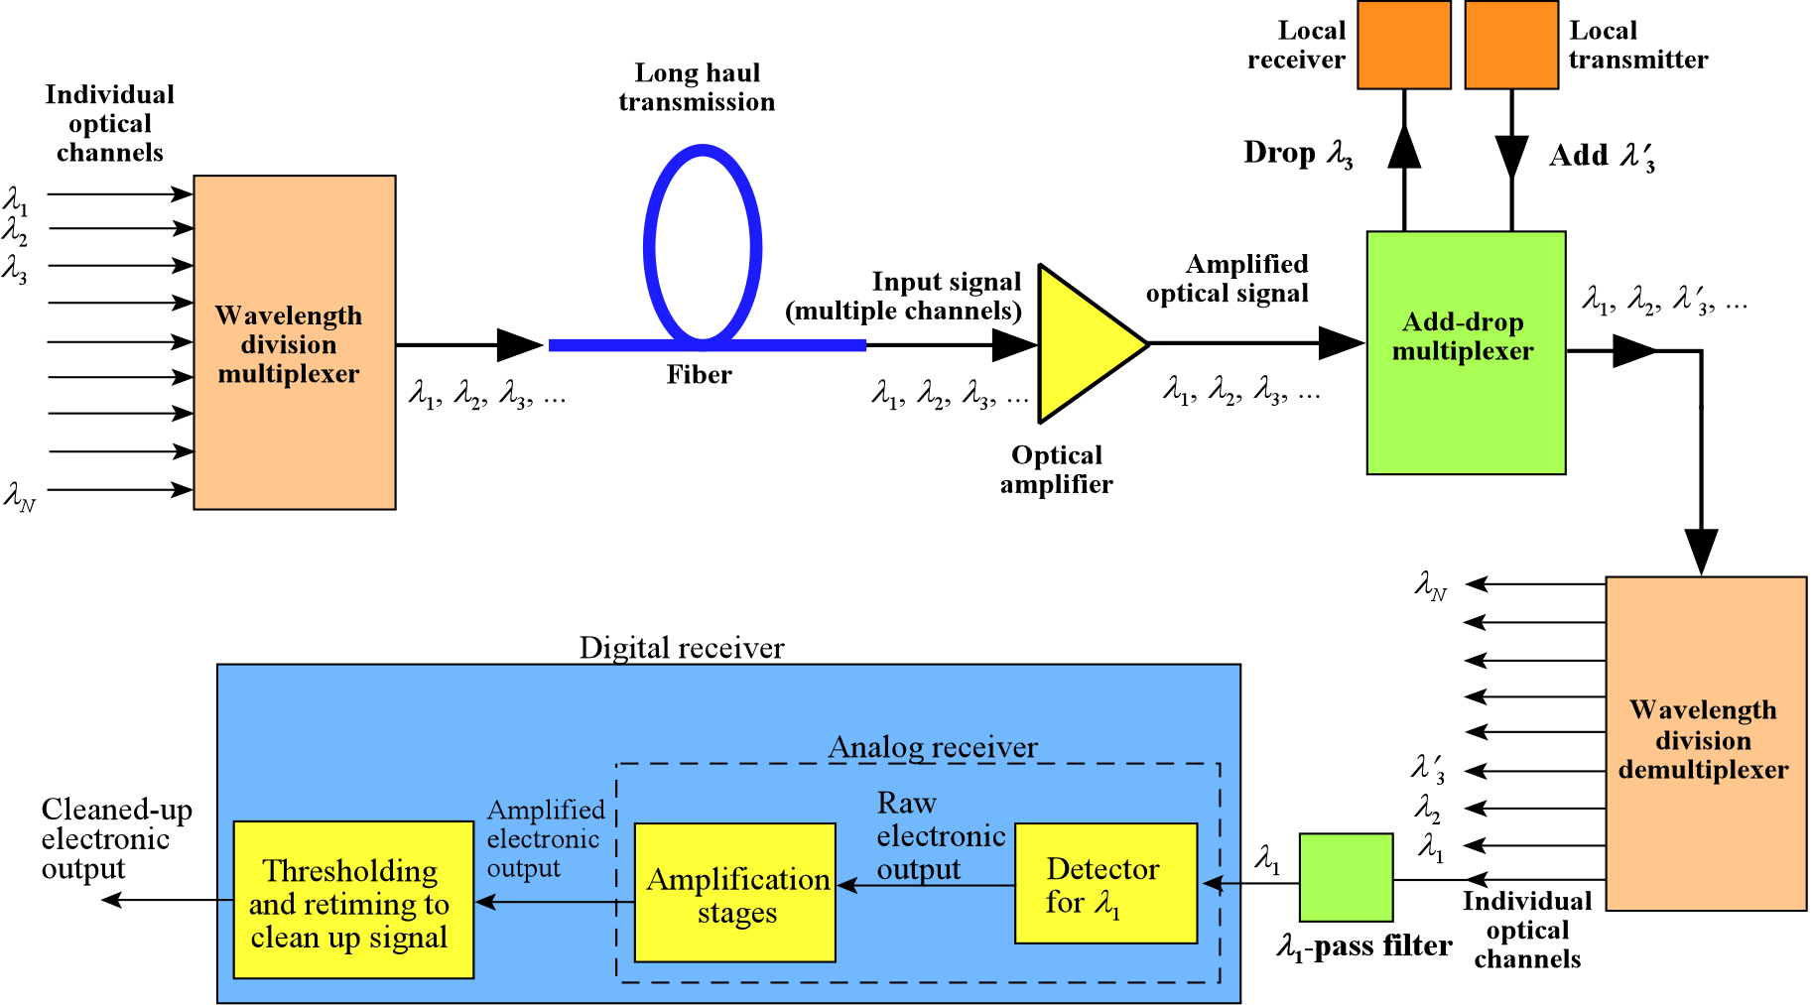
WAVELENGTH DIVISION MULTIPLEXING: WDM

Slide 13
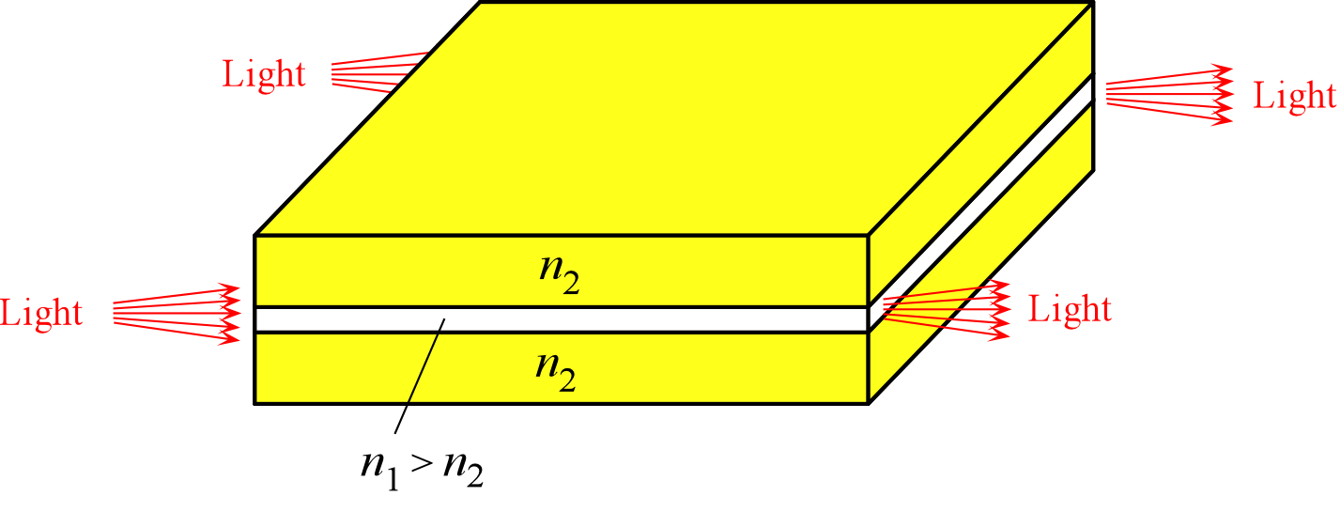
Planar Optical Waveguide
A planar dielectric waveguide has a central rectangular region of higher refractive index n₁ than the surrounding region which has a refractive index n₂. It is assumed that the waveguide is infinitely wide and the central region is of thickness 2a. It is illuminated at one end by a nearly monochromatic light source.

Slide 14
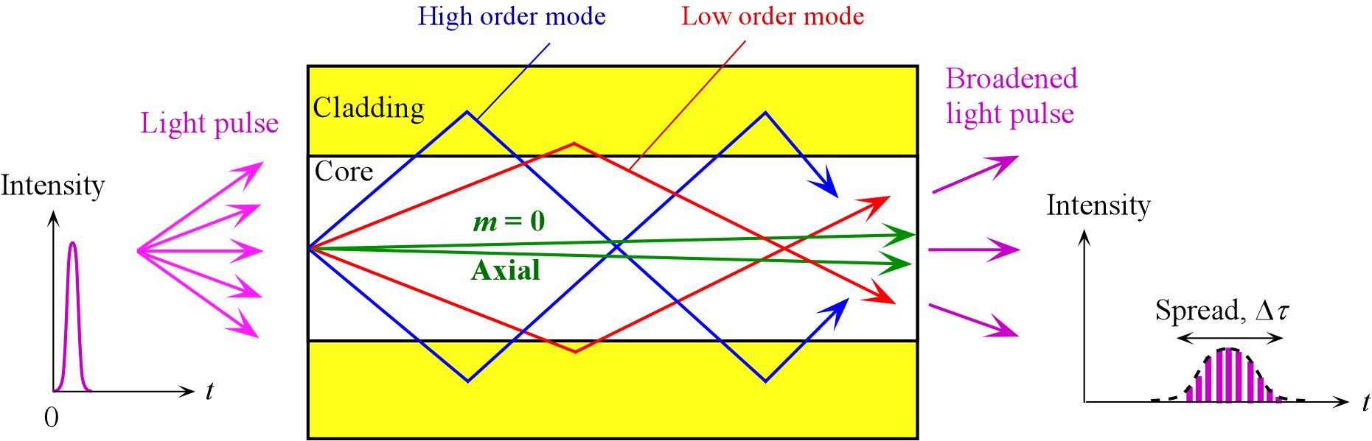
Optical Waveguide
Light waves zigzag along the guide. Is that really what happens?

Slide 15
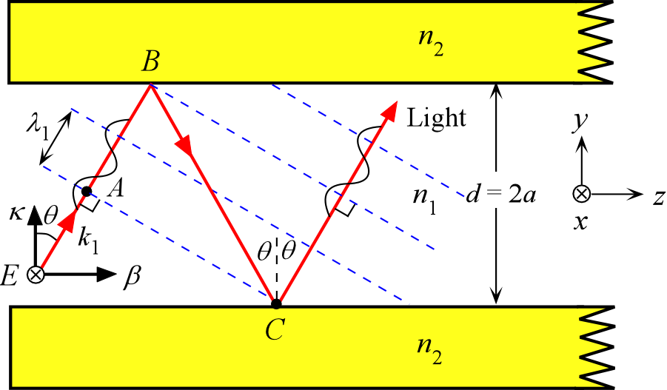
Waves Inside the Core
A light ray traveling in the guide must interfere constructively with itself to propagate successfully. Otherwise destructive interference will destroy the wave. E is parallel to x. (λ₁ and k₁ are the wavelength and the propagation constant inside the core medium n₁ i.e. λ₁ = λ/n₁.)

Slide 16
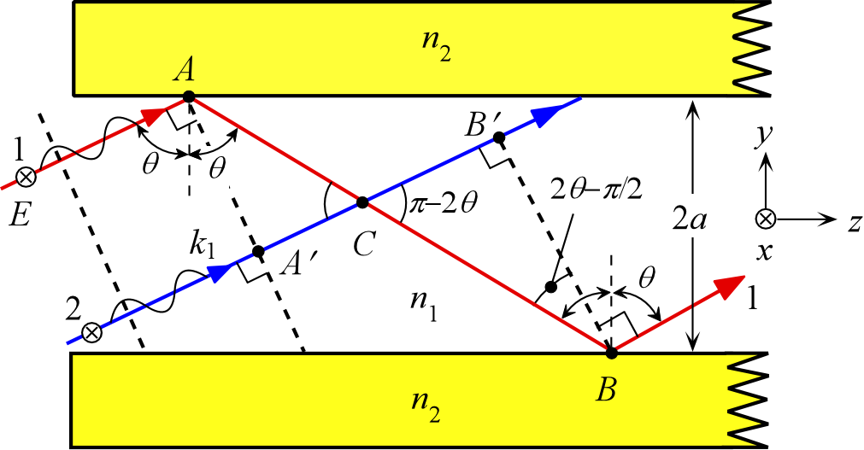
Waves Inside the Core
Two arbitrary waves 1 and 2 that are initially in phase must remain in phase after reflections. Otherwise the two will interfere destructively and cancel each other.

Slide 17
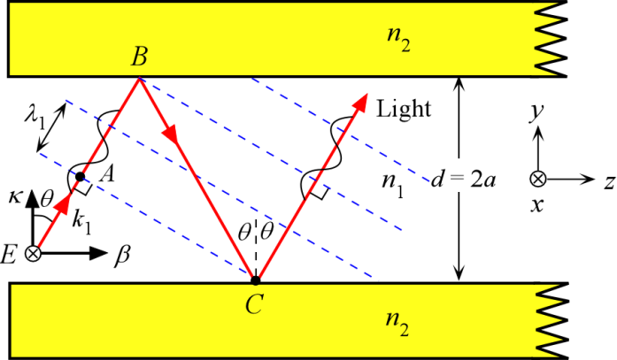
Waveguide Condition
and
Modes
k₁ = kn₁ = 2πn₁/λ,
Δφ(AC) = k₁(AB + BC) − 2φ = m(2π)
BC = d/cosθ and AB = BCcos(2θ)
AB + BC = BCcos(2θ) + BC = BC[(2cos²θ −1) + 1] = 2dcosθ
k₁[2dcosθ] − 2φ = m(2π)
m = 0, 1, 2, 3 etc
Integer
“Mode number”
Waveguide condition

Slide 18
Propagation constant along the guide
Transverse Propagation constant

Slide 19
Waveguide Condition and Waveguide Modes
To get a propagating wave along a guide you must have constructive interference. All these rays interfere with each other. Only certain angles are allowed . Each allowed angle represents a mode of propagation.

Slide 20
Waveguide Condition
m = integer, n₁ = core refractive index, θ_{m} is the incidence angle, 2a is the core thickness.
Minimum θ_{m} and maximum m must still satisfy TIR.
There are only a finite number of modes.
Propagation along the guide for a mode m is

Slide 21
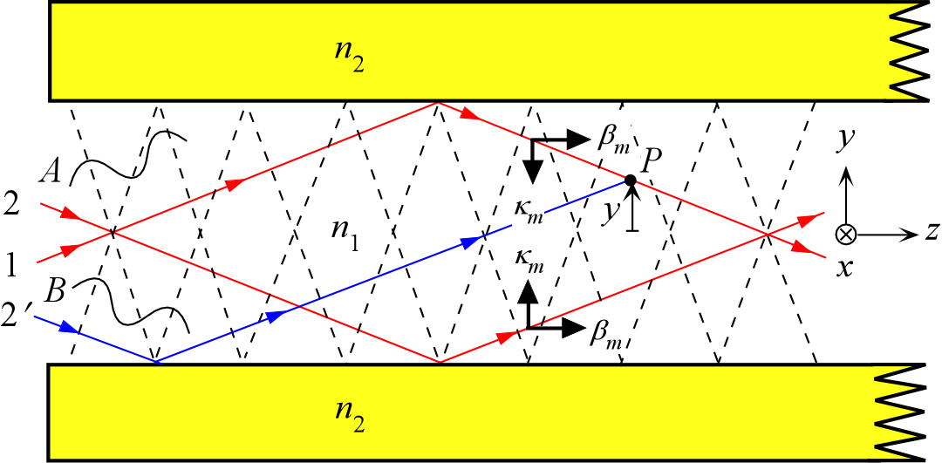
Waveguide Condition and Modes
To get a propagating wave along a guide you must have constructive interference. All these rays interfere with each other. Only certain angles are allowed . Each allowed angle represents a mode of propagation.

Slide 22

Modes in a Planar Waveguide
We can identify upward (A) and downward (B) traveling waves in the guide which interfere to set up a standing wave along y and a wave that is propagating along z. Rays 2 and 2′ belong to the same wave front but 2′ becomes reflected before 2. The interference of 1 and 2′ determines the field at a height y from the guide center. The field E(y, z, t) at P can be written as
E(y,z,t) = E_{m}(y)cos(ωt − β_{m}z)
Traveling wave along z
Field pattern along y

Slide 23
Modes in a Planar Waveguide: Summary
m = integer, n₁ = core refractive index, θ_{m} is the incidence angle, 2a is the core thickness.
E(y,z,t) = E_{m}(y)cos(ωt − β_{m}z)
Traveling wave along z
Field pattern along y

Slide 24
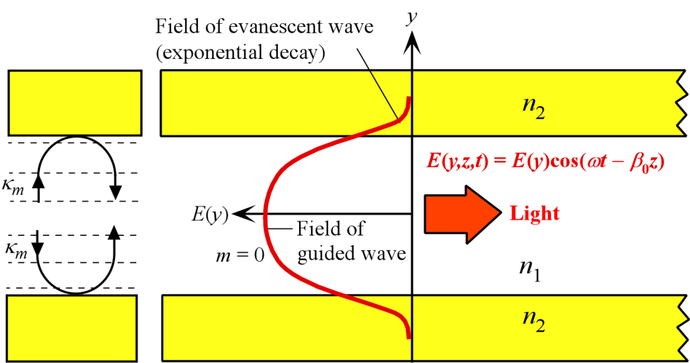
Mode Field Pattern
Left: The upward and downward traveling waves have equal but opposite wavevectors κ_{m} and interfere to set up a standing electric field pattern across the guide. Right: The electric field pattern of the lowest mode traveling wave along the guide. This mode has m = 0 and the highest θ. It is often referred to as the glazing incidence ray. It has the highest phase velocity along the guide

Slide 25
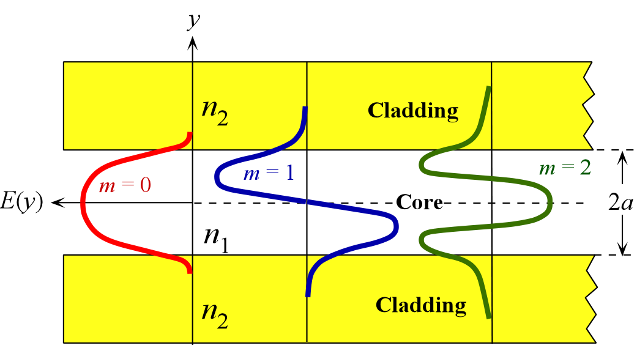
Modes in a Planar Waveguide
The electric field patterns of the first three modes (m = 0, 1, 2) traveling wave along the guide. Notice different extents of field penetration into the cladding

Slide 26
Intermode (Intermodal or Modal) Dispersion
Schematic illustration of light propagation in a slab dielectric waveguide. Light pulse entering the waveguide breaks up into various modes which then propagate at different group velocities down the guide. At the end of the guide, the modes combine to constitute the output light pulse which is broader than the input light pulse.

Slide 27
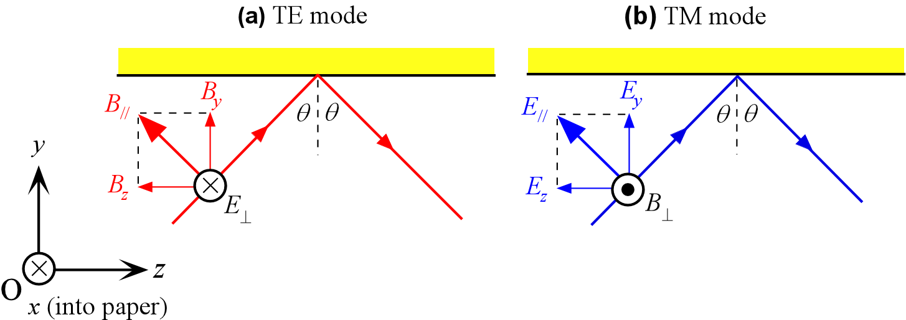
TE and TM Modes
E⊥ is along x, so that E⊥ = E_{x}
B⊥ is along − x, so that B⊥ = −B_{x}
Possible modes can be classified in terms of (a) transverse electric field (TE) and (b) transverse magnetic field (TM). Plane of incidence is the paper.

Slide 28
V-Number
All waveguides are characterized by a parameter called the V-number or normalized frequency
V < π/2, m = 0 is the only possibility and only the fundamental mode (m = 0) propagates along the dielectric slab waveguide: a single mode planar waveguide.
λ = λ_{c} for V = π/2 is the cut-off wavelength, and above this wavelength, only one-mode, the fundamental mode will propagate.

Slide 29
Example on Waveguide Modes
Consider a planar dielectric guide with a core thickness 20 μm, n₁ = 1.455, n₂ = 1.440, light wavelength of 900 nm. Find the modes
TIR phase change φ_{m} for TE mode
TE mode
Waveguide condition
Waveguide condition

Slide 30
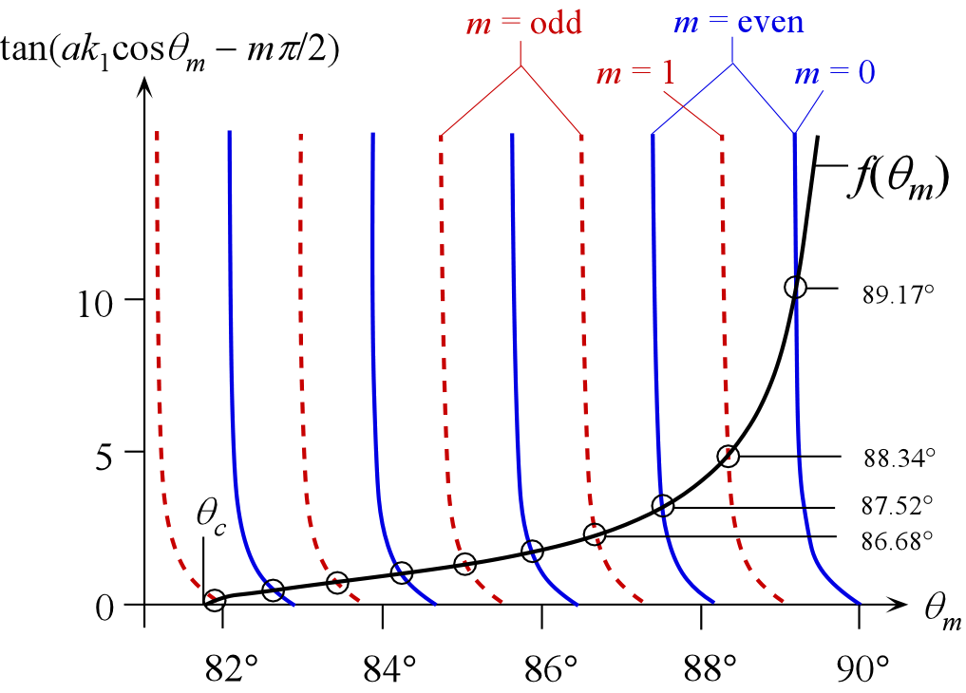
TE mode

Slide 31
Mode m, incidence angle θ_{m} and penetration δ_{m} for a planar dielectric waveguide with d = 2a = 20 μm, n₁ = 1.455, n₂ = 1.440 (λ = 900 nm)
m | 0 | 1 | 2 | 3 | 4 | 5 | 6 | 7 | 8 | 9
θ_{m} | 89.2° | 88.3° | 87.5° | 86.7° | 85.9° | 85.0° | 84.2° | 83.4° | 82.6° | 81.9°
δ_{m} (μm) | 0.691 | 0.702 | 0.722 | 0.751 | 0.793 | 0.866 | 0.970 | 1.15 | 1.57 | 3.83
m = 0
Fundamental
mode
Highest
mode
Critical angle θ_{c} = arcsin(n₂/n₁) = 81.77°
Notes:
31

Slide 32
Number of Modes M
Waveguide condition
One mode when V < π/2
Multimode when V > π/2

Slide 33
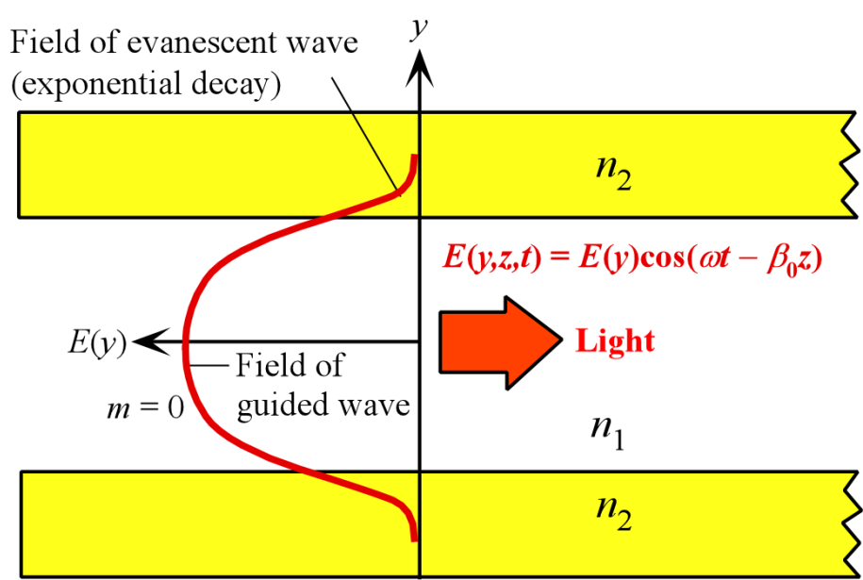
Mode Field Width 2w_{o}
E_{cladding}(y′) = E_{cladding}(0)exp(−α_{cladding}y′)
Mode Field Width 2w_{o}
Note: The MFW definition here is semiquantitive. A more rigorous approach needs to consider the optical power in the mode and how much of this penetrates the cladding. See optical fibers section.

Slide 34
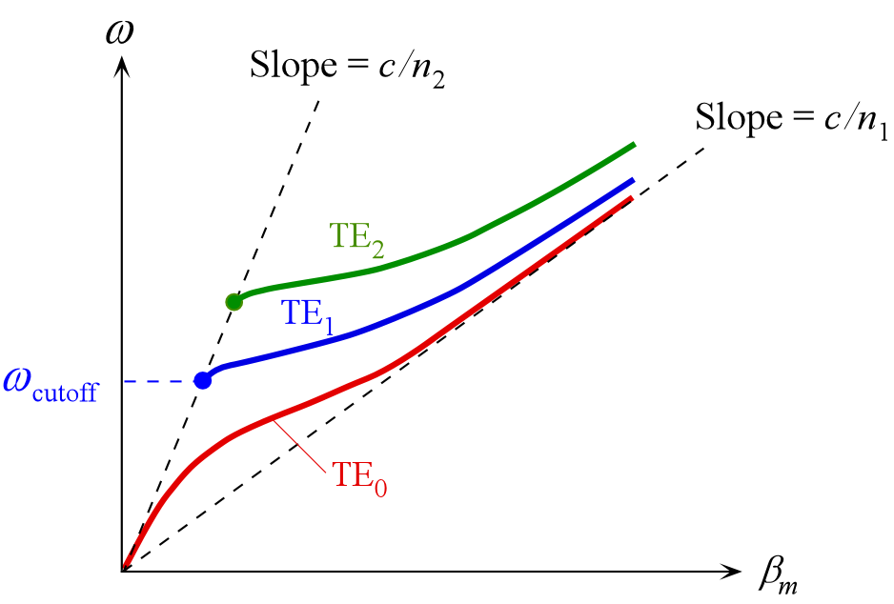
Waveguide Dispersion Curve
The slope of ω vs. β is the group velocity v_{g}

Slide 35
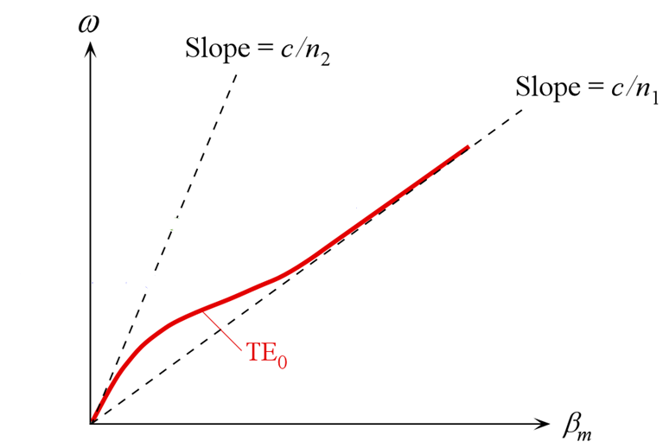
Waveguide Dispersion Curve
Slope = Group Velocity
The slope of ω vs. β is the group velocity v_{g}
ω
β_{m}

Slide 36
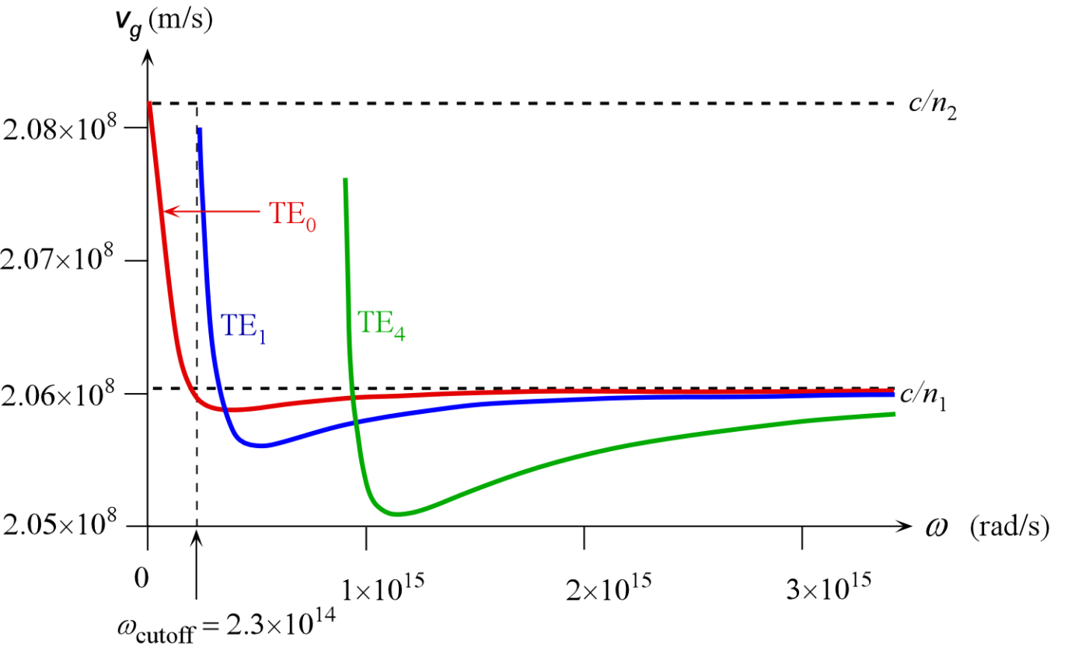
Mode Group Velocities from Dispersion Diagram
Group velocity vs. frequency or wavelength behavior is not obvious. For the first few modes, a higher mode can travel faster than the fundamental.
The group velocity v_{g} vs. ω for a planar dielectric guide with a core thickness (2a) = 20 μm, n₁ = 1.455, n₂ = 1.440. TE₀, TE₁ and TE₄

Slide 37
A Planar Dielectric Waveguide with Many Modes
Not in the textbook
2.08
c / n₂
m = 0
2.07
×10⁸
m = 10
2.06
c / n₁
v_{g}
2.05
Slower than fundamental
ΤΕ₁ ω_{cutoff}
m = 20
m = 30
m = 40
m = 60
2.04
(c/n₁)sinθ_{c} = cn₂/n₁²
0
0.5×10¹⁶
1.0×10¹⁶
1.5×10¹⁶
ω
The group velocity v_{g} vs. ω for a planar dielectric guide Core thickness (2a) = 20 μm, n₁ = 1.455, n₂ = 1.440
[Calculations by the author]

Slide 38
Dispersion in the Planar Dielectric Waveguide with TE₀ and TE₁ (Near cut-off)
Not in the textbook
ω₁
ω₁
TE₁
Broadened pulse
TE₀
=
Input light
pulse
Output light pulse
ω_{cutoff}
v_{gmax} ≈ c/n₂
c / n₂
v_{gmax}
v_{gmin} ≈ c/n₁
TE₀
v_{g}
TE₂
Spread in arrival times
TE₁
v_{gmin}
c / n₁
ω
Dispersion
Operating frequency ω₁
λ₁ = 2πc/ω₁

Slide 39
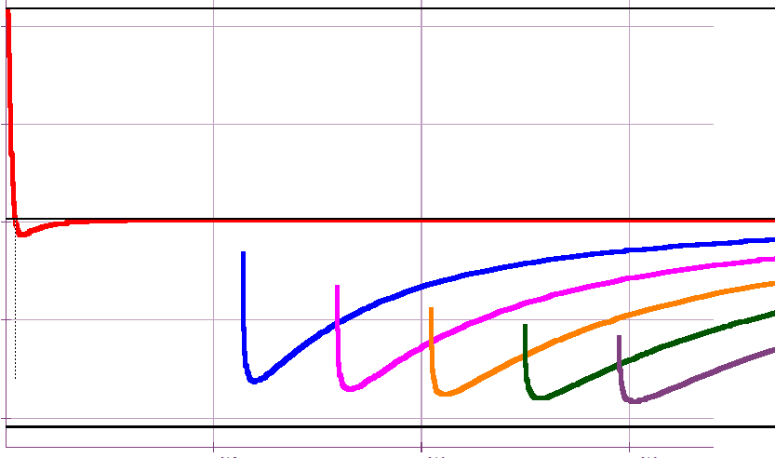
A Planar Dielectric Waveguide with Many Modes
Not in the textbook
m = 0
m = 25
m = 35
m = 45
m = 55
m = 65
2.08
c / n₂
Operating frequency
2.07
×10⁸
2.06
c / n₁
v_{g}
Range of group velocities for 65 modes
2.05
ω_{cutoff}
2.04
(c/n₁)sinθ_{c} = cn₂/n₁²
0
0.5×10¹⁶
1.0×10¹⁶
1.5×10¹⁶
ω
Multimode operation in which many modes propagate with different group velocities
v_{g} vs. ω for a planar dielectric guide with a core thickness (2a) = 20 μm, n₁ = 1.455, n₂ = 1.440 [Calculations by the author]

Slide 40
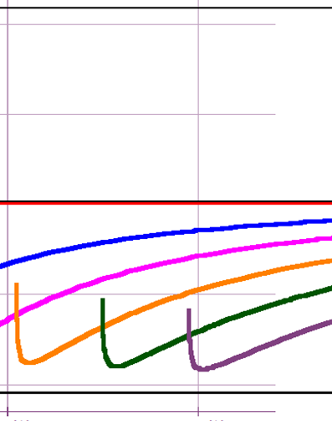
Dispersion in the Planar Dielectric Waveguide with Many Modes Far from Cutoff
Not in the textbook
c / n₂
c/n₁
Operating frequency
θ_{c}
θ_{c}
(c/n₁)sinθ_{c}
c/n₁
c / n₁
TE_{highest}
v_{g}
Range of group velocities for 65 modes
(c/n₁)sinθ_{c}
ω
(Since n₁ and n₂ are only slightly different.)

Slide 41
Dispersion in the Planar Dielectric Waveguide Many Modes
Not in the textbook
ω₂
Δτ
θ_{c}
θ_{c}
=
TE₀
ω₂
Very short input pulse
Output
pulse
Broadened pulse
TE_{highest}
(Since n₁/n₂ ≈ 1)

Slide 42
How can a higher mode such as TE₁ or TE₂ travel faster than the fundamental near cut-off?
Not in the textbook
θ_{c}
TE1 near cut-off
Penetration depth δ_{m}
Fundamental mode
Incidence angle θ_{i}
The mode TE₁ penetrates into the cladding where its velocity is higher than in the core. If penetration is large, as near cut-off, TE₁ group velocity along the guide can exceed that of TE₀.
Notes:
42

Slide 43
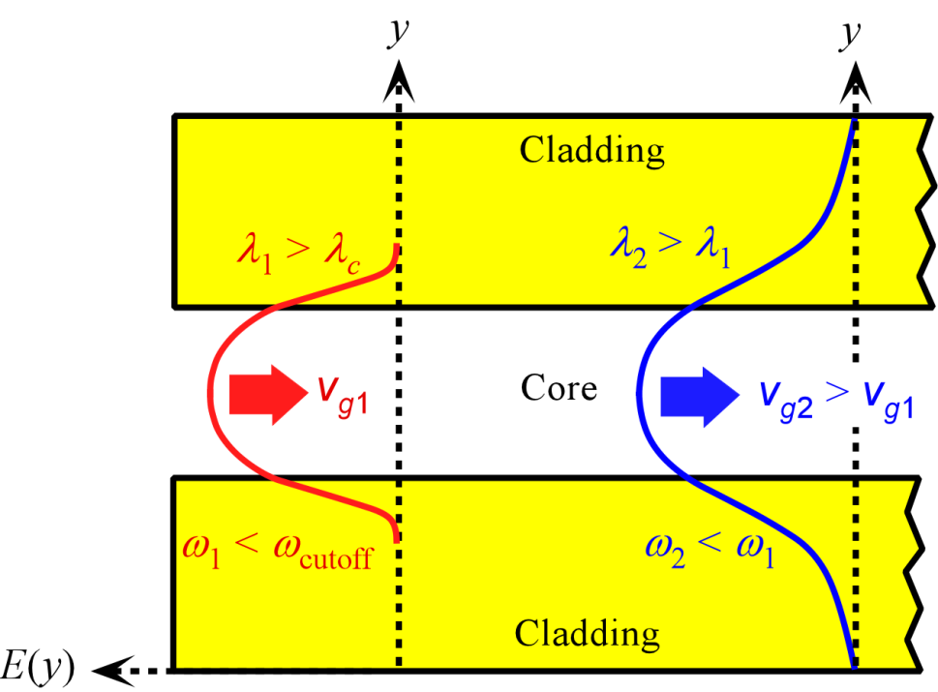
Group Velocity and Wavelength: Fundamental Mode
The electric field of TE₀ mode extends more into the cladding as the wavelength increases. As more of the field is carried by the cladding, the group velocity increases.

Slide 44
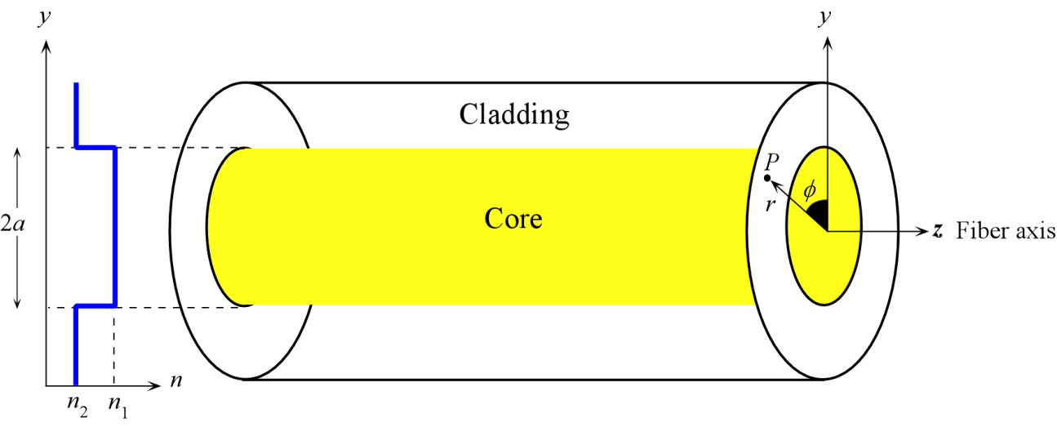
Optical Fibers
The step index optical fiber. The central region, the core, has greater refractive index than the outer region, the cladding. The fiber has cylindrical symmetry. The coordinates r, φ, z are used to represent any point P in the fiber. Cladding is normally much thicker than shown.

Slide 45
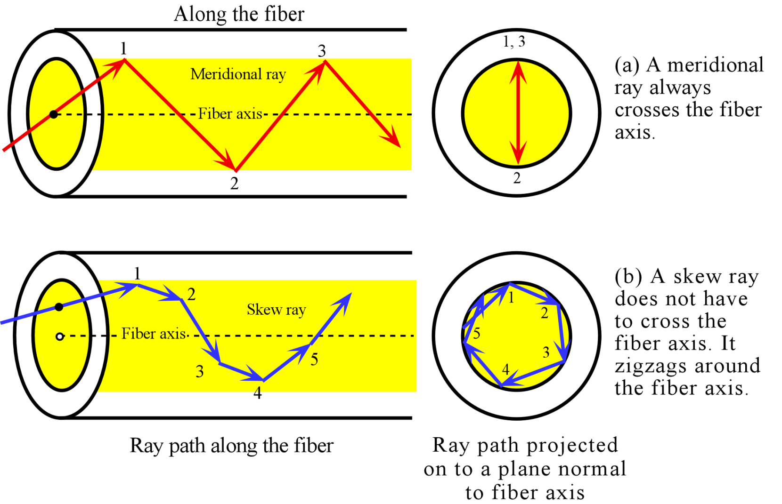
Meridional ray enters the fiber through the fiber axis and hence also crosses the fiber axis on each reflection as it zigzags down the fiber. It travels in a plane that contains the fiber axis.
Skew ray enters the fiber off the fiber axis and zigzags down the fiber without crossing the axis

Slide 46
Modes LP_{lm}
Weakly guiding modes in fibers
Δ << 1 weakly guiding fibers
E_{LP} = E_{lm}(r,φ) expj(ωt − β_{lm}z)
Field
Pattern
Traveling wave
E and B are 90º to each other and z

Slide 47
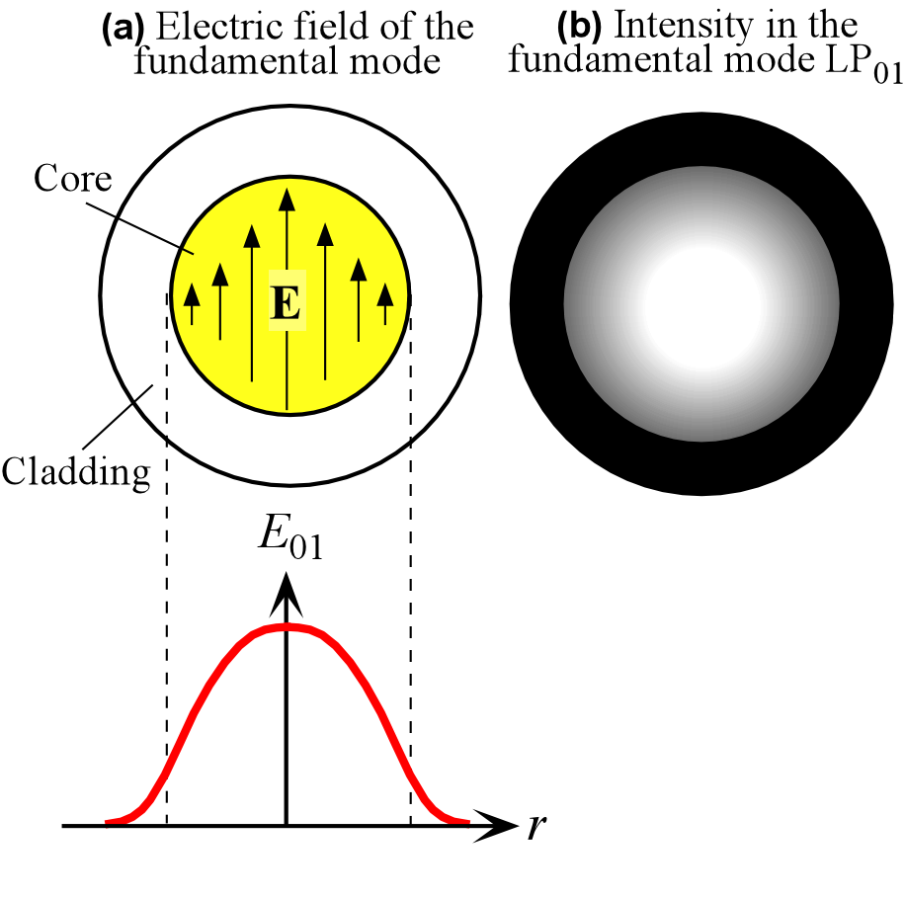
Fundamental Mode is the LP₀₁ mode: l = 0 and m = 1
The electric field distribution of the fundamental mode, LP₀₁, in the transverse plane to the fiber axis z. The light intensity is greatest at the center of the fiber

Slide 48
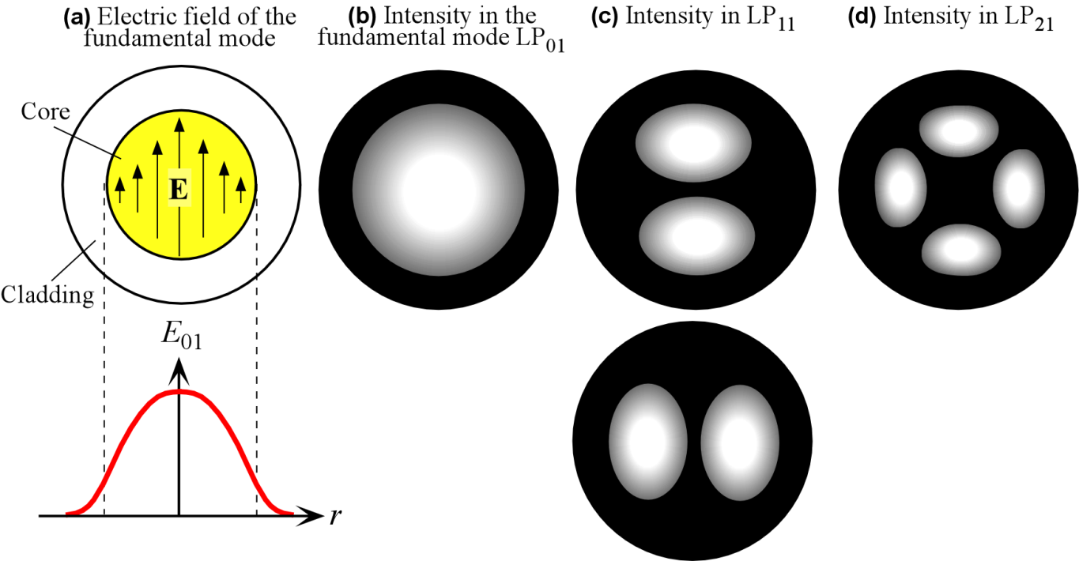
The electric field distribution of the fundamental mode in the transverse plane to the fiber axis z. The light intensity is greatest at the center of the fiber. Intensity patterns in LP₀₁, LP₁₁ and LP₂₁ modes. (a) The field in the fundamental mode. (b)-(d) Indicative light intensity distributions in three modes, LP₀₁, LP₁₁ and LP₂₁.

Slide 49
LP_{lm}
E_{LP} = E_{lm}(r,φ) expj(ωt − β_{lm}z)
m = number of maxima along r starting from the core center. Determines the reflection angle θ
2l = number of maxima around a circumference
l - radial mode number
l - extent of helical propagation, i.e. the amount of skew ray contribution to the mode.

Slide 50
Optical Fiber Parameters
n = (n₁ + n₂)/2 = average refractive index
= normalized index difference
Δ = (n₁ − n₂)/n₁ ≈ (n₁² − n₂²)/2n₁²
V-number
V < 2.405 only 1 mode exists. Fundamental mode
V < 2.405 or λ > λ_{c} Single mode fiber
V > 2.405 Multimode fiber
Number of modes

Slide 51
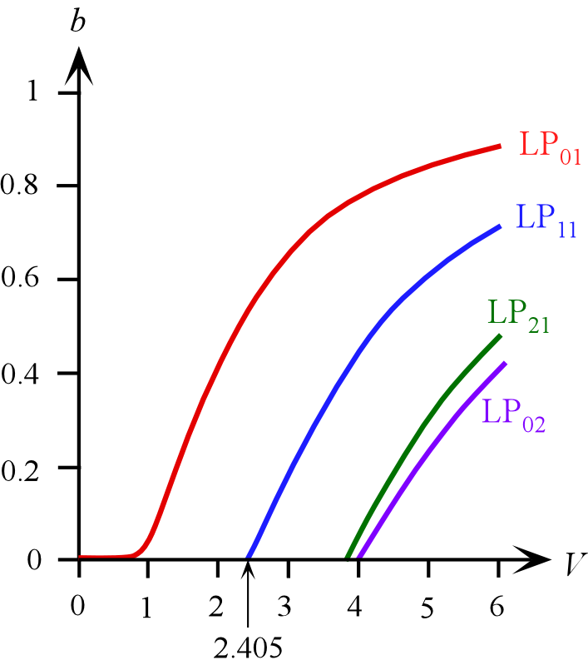
Modes in an Optical Fiber
Normalized propagation constant
( 1.5 < V < 2.5)
k = 2π/λ
Normalized propagation constant b vs. V-number for a step-index fiber for various LP modes

Slide 52
Modes in an Optical Fiber
Normalized propagation constant can also be defined as
( 1.5 < V < 2.5)
k = 2π/λ
Normalized propagation constant b vs. V-number for a step-index fiber for various LP modes

Slide 53
Group Velocity and Group Delay
Consider a single mode fiber with core and cladding indices of 1.4480 and 1.4400, core radius of 3 μm, operating at 1.5 μm. What are the group velocity and group delay at this wavelength?
β = n₂k[1 + bΔ]
k = 2π/λ = 4,188,790 m⁻¹ and ω = 2πc/λ = 1.255757×10¹⁵ rad s⁻¹
V = (2πa/λ)(n₁² − n₂² )^{1/2} = 1.910088
1.5 < V < 2.5
b = 0.3860859, and β = 6.044796×10⁶ m⁻¹.
Increase wavelength by 0.1% and recalculate. Values in the table

Slide 54
Group Velocity and Group Delay
Calculation → | V | k (m⁻¹) | ω (rad s⁻¹) | b | β (m⁻¹)
λ = 1.500000 μm | 1.910088 | 4188790 | 1.255757×10¹⁵ | 0.3860859 | 6.044818×10⁶
λ′ = 1.50150 μm | 1.908180 | 4184606 | 1.254503×10¹⁵ | 0.3854382 | 6.038757×10⁶
The group delay τ_{g} over 1 km is 4.83 μs

Slide 55
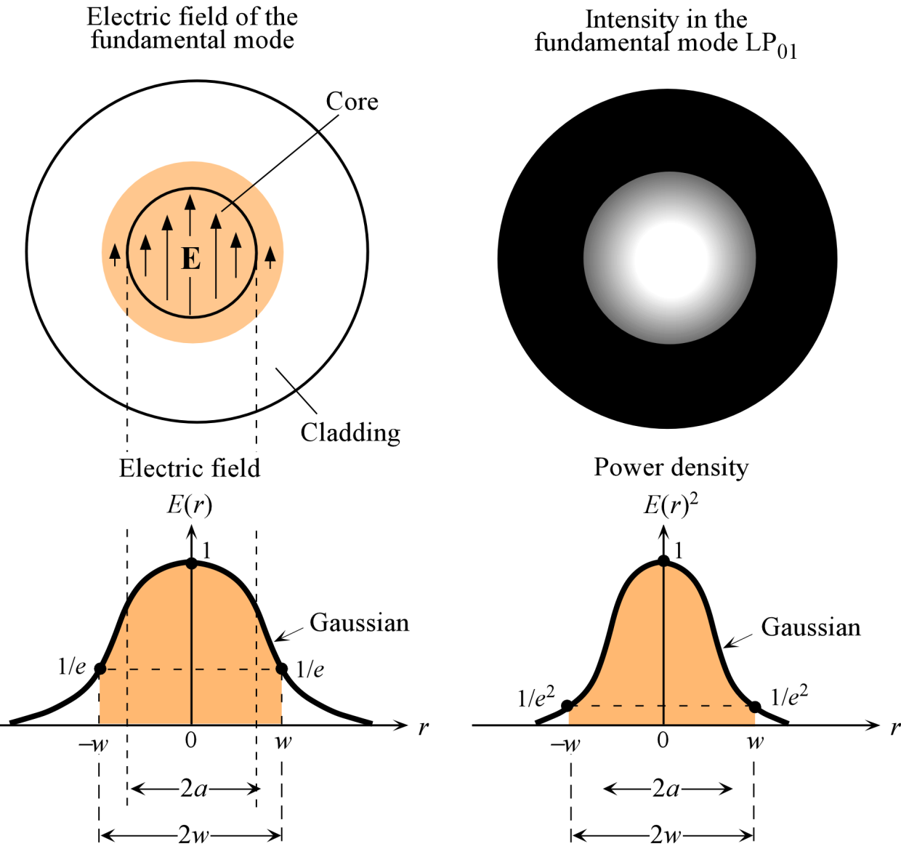
Mode Field Diameter (2w)
Note: Maximum set arbitrarily to 1
Intensity ∝ v_{g}×E(r)²
Gaussian
Gaussian

Slide 56
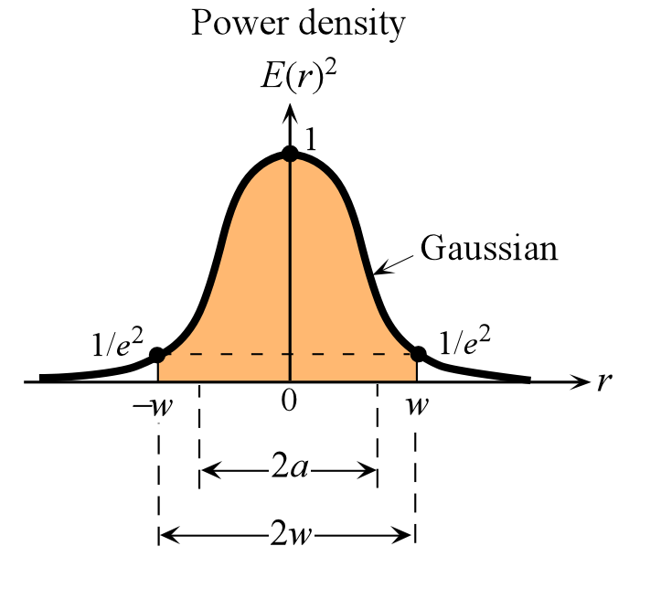
Mode Field Diameter
Note: Maximum set arbitrarily to 1
Intensity ∝ v_{g}×E(r)²
2w = Mode Field Diameter (MFD)
Marcuse MFD Equation
0.8 < V < 2.5
2w ≈ (2a)(2.6/V)
1.6 < V < 2.4

Slide 57
Correction note p113
Applies to print version only; e-version is correct
Insert this 2 as superscript on e in Figure 2.16
Insert this 2 in Equation (2.3.7)

Slide 58
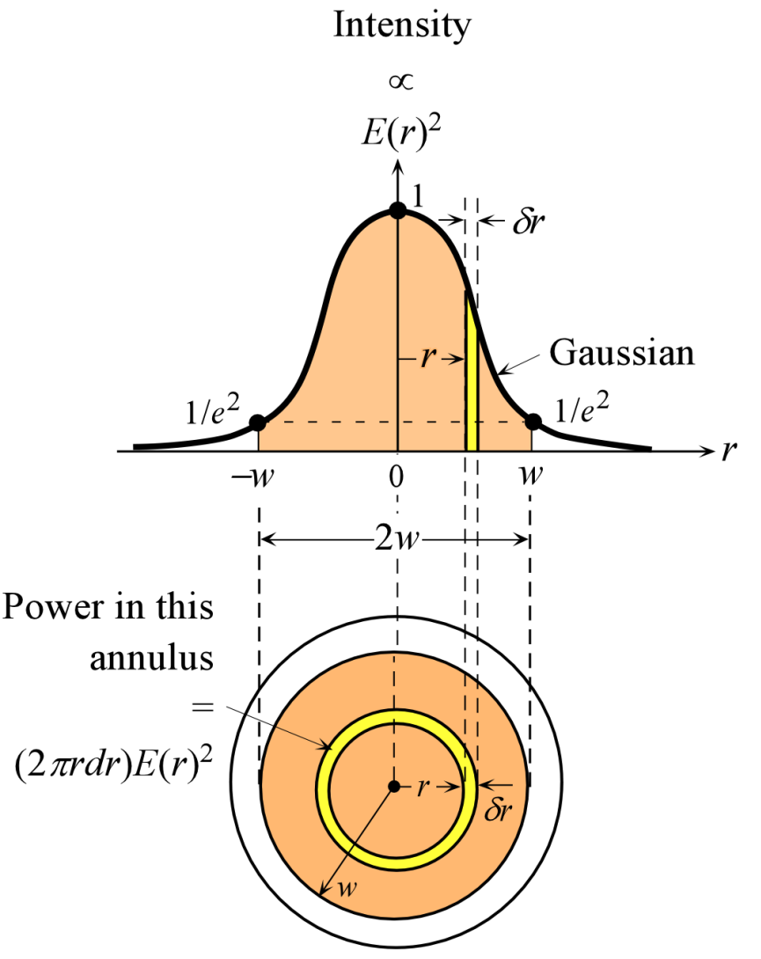
Not in the textbook
Mode Field Diameter (2w)
Intensity ∝ v_{g}×E(r)²
and
Area of a circular thin strip (annulus) with radius r is 2πrdr. Power passing through this strip is proportional to
E(r)²(2πr)dr
Fraction of optical power within MFD
=

Slide 59
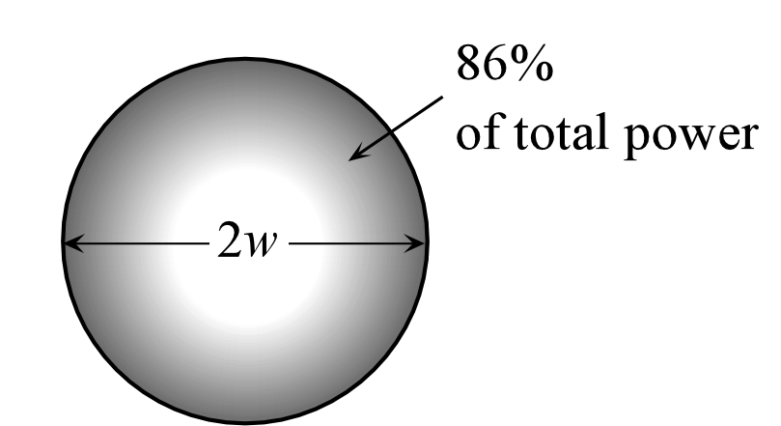
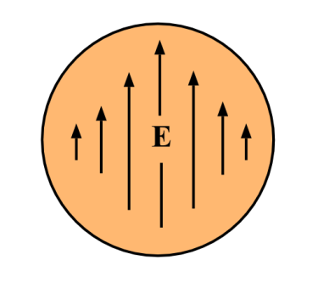
Mode Field Diameter (2w)
86% of total power
Fraction of optical power within MFD
= 86 %
This is the same as the fraction of optical power within a radius w from the axis of a Gaussian beam (See Chapter 1)

Slide 60
Example: A multimode fiber
Calculate the number of allowed modes in a multimode step index fiber which has a core of refractive index of 1.468 and diameter 100 μm, and a cladding of refractive index of 1.447 if the source wavelength is 850 nm.
Solution
Substitute, a = 50 μm, λ = 0.850 μm, n₁ = 1.468, n₂ = 1.447 into the expression for the V-number,
V = (2πa/λ)(n₁² − n₂²)^{1/2} = (2π50/0.850)(1.468² − 1.447²)^{1/2}
= 91.44.
Since V >> 2.405, the number of modes is
M ≈ V²/2 = (91.44)²/2 = 4181
which is large.

Slide 61
Example: A single mode fiber
What should be the core radius of a single mode fiber which has a core of n₁ = 1.4680, cladding of n₂ = 1.447 and it is to be used with a source wavelength of 1.3 μm?
Solution
For single mode propagation, V ≤ 2.405. We need,
V = (2πa/λ)(n₁² − n₂²)^{1/2} ≤ 2.405
or
[2πa/(1.3 μm)](1.468² − 1.447²)^{1/2} ≤ 2.405
which gives a ≤ 2.01 μm.
Rather thin for easy coupling of the fiber to a light source or to another fiber; a is comparable to λ which means that the geometric ray picture, strictly, cannot be used to describe light propagation.

Slide 62
Example: Single mode cut-off wavelength
Calculate the cut-off wavelength for single mode operation for a fiber that has a core with diameter of 8.2 μm, a refractive index of 1.4532, and a cladding of refractive index of 1.4485. What is the V-number and the mode field diameter (MFD) for operation at λ = 1.31 μm?
Solution
For single mode operation,
V = (2πa/λ)(n₁² − n₂² )^{1/2} ≤ 2.405
Substituting for a, n₁ and n₂ and rearranging we get,
λ > [2π(4.1 μm)(1.4532² − 1.4485²)^{1/2}]/2.405 = 1.251 μm
Wavelengths shorter than 1.251 μm give multimode propagation.
At λ = 1.31 μm,
V = 2π[(4.1 μm)/(1.31 μm)](1.4532² − 1.4485²)^{1/2} = 2.30
Mode field diameter MFD

Slide 63
Solution (continued)
Mode field diameter MFD from the Marcuse Equation is
2w = 9.30 μm
86% of total power is within this diameter
2w = (2a)(2.6/V) = 2(4.1)(2.6/2.30) = 9.28 μm
2w = 2a[(V+1)/V] = 11.8 μm
This is for a planar waveguide, and the definition is different than that for an optical fiber

Slide 64
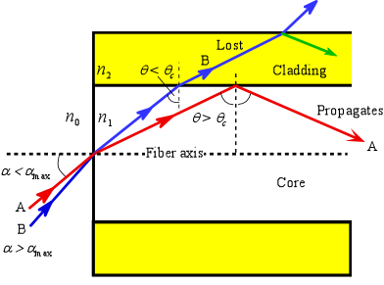
Numerical Aperture NA
Maximum acceptance angle α_{max} is that which just gives total internal reflection at the core-cladding interface, i.e. when α = α_{max} then θ = θ_{c}. Rays with α > α_{max} (e.g. ray B) become refracted and penetrate the cladding and are eventually lost.
2α_{max} = total acceptance angle
NA is an important factor in light launching designs into the optical fiber.

Slide 65
Example: A multimode fiber and total acceptance angle
A step index fiber has a core diameter of 100 μm and a refractive index of 1.480. The cladding has a refractive index of 1.460. Calculate the numerical aperture of the fiber, acceptance angle from air, and the number of modes sustained when the source wavelength is 850 nm.
Solution
The numerical aperture is
NA = (n₁² − n₂²)^{1/2} = (1.480² − 1.460²)^{1/2} = 0.2425 or 24.3%
From, sinα_{max} = NA/n_{o} = 0.2425/1
Acceptance angle α_{max} = 14°
Total acceptance angle 2α_{max} = 28°
V-number in terms of the numerical aperture can be written as,
V = (2πa/λ)NA = [(2π50 μm)/(0.85 μm)](0.2425) = 89.62
The number of modes, M ≈ V²/2 = 4016
Normalized refractive index
Δ = (n₁ − n₂) / n₁ = 0.0135 or 1.35%

Slide 66
Example: A single mode fiber and cut-off wavelength
A typical single mode optical fiber has a core of diameter 8 μm and a refractive index of 1.460. The normalized index difference is 0.3%. The cladding diameter is 125 μm. Calculate the numerical aperture and the total acceptance angle of the fiber. What is the single mode cut-off frequency λ_{c} of the fiber?
Solution
The numerical aperture
NA = (n₁² − n₂²)^{1/2} = [(n₁ + n₂)(n₁ − n₂)]^{1/2}
Substituting (n₁ − n₂) = n₁Δ and (n₁ + n₂) ≈ 2n₁, we get
NA ≈ [(2n₁)(n₁Δ)]^{1/2} = n₁(2Δ)^{1/2} = 1.46(2×0.003)^{1/2} = 0.113 or 11.3 %
The acceptance angle is given by
sinα_{max} = NA/n_{o} = 0.113/1 or α_{max} = 6.5°, and 2α_{max} = 13°
The condition for single mode propagation is V ≤ 2.405. At cut-off,
V = (2πa/λ_{c})(n₁² − n₂² )^{1/2} = 2.405
∴ λ_{c} = [2πaNA]/2.405 = [(2π)(4 μm)(0.113)]/2.405 = 1.18 μm
Wavelengths shorter than 1.18 μm will result in multimode operation.

Slide 67
Dispersion = Spread of Information
Intermode (Intermodal) Dispersion: Multimode fibers only
Material Dispersion Group velocity depends on N_{g} and hence on λ
Waveguide Dispersion Group velocity depends on waveguide structure
Chromatic Dispersion Material dispersion + Waveguide Dispersion
Polarization Dispersion
Profile Dispersion Like material and waveguide dispersion. Add all 3 Material + Waveguide + Profile
Self phase modulation dispersion

Slide 68
Intermode Dispersion (MMF)
Group Delay τ = L / v_{g}
(Since n₁ and n₂ are only slightly different)

Slide 69
Intermode Dispersion (MMF)
θ_{c}
TE₀
θ_{c}
TE_{highest}
Δτ/L ≈ 10 − 50 ns / km
Depends on length!

Slide 70
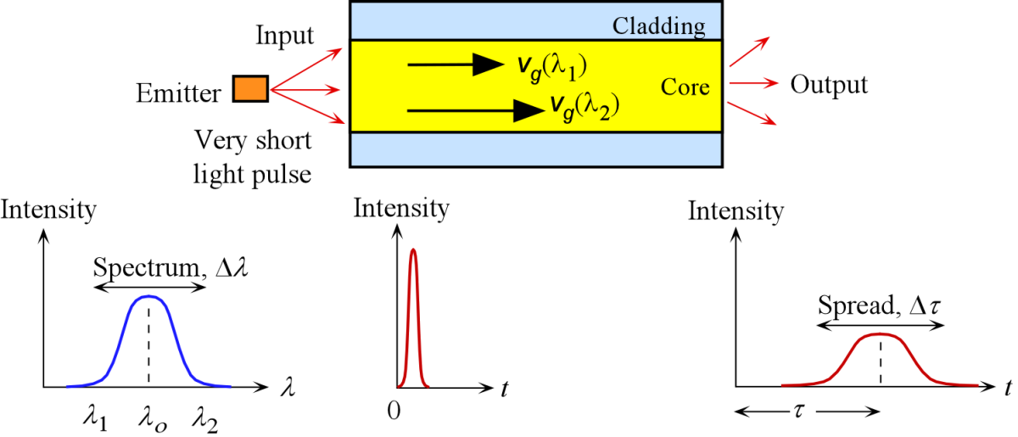
Intramode Dispersion (SMF)
Dispersion in the fundamental mode
Group Delay τ = L / v_{g}
Group velocity v_{g} depends on
Refractive index = n(λ) Material Dispersion
V-number = V(λ) Waveguide Dispersion
Δ = (n₁ − n₂)/n₁ = Δ(λ) Profile Dispersion

Slide 71
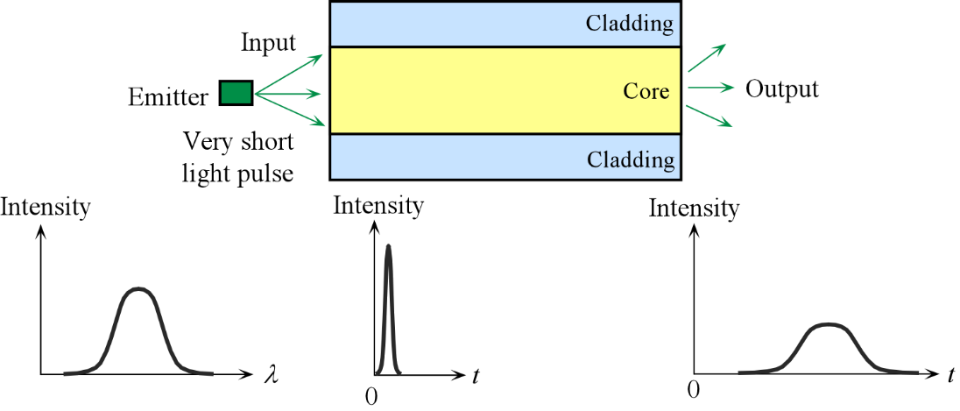
Intramode Dispersion (SMF)
Chromatic dispersion in the fundamental mode
v_{g1}
v_{g2}
Output pulse dispersed
δ(t)
τ
λ₁
λ₂
τ_{g1}
τ_{g2}
Δλ
Δτ
Δλ = λ₂ − λ₁
Δτ = τ_{g2} − τ_{g1}
Chromatic spread
Dispersion
OR
Definition of Dispersion Coefficient

Slide 72

Material Dispersion
Emitter emits a spectrum ∆λ of wavelengths.
Waves in the guide with different free space wavelengths travel at different group velocities due to the wavelength dependence of n₁. The waves arrive at the end of the fiber at different times and hence result in a broadened output pulse.
D_{m} = Material dispersion coefficient, ps nm⁻¹ km⁻¹

Slide 73
Material Dispersion
v_{g} = c / N_{g}
Group velocity
Depends on the wavelength
D_{m} = Material dispersion coefficient, ps nm⁻¹ km⁻¹

Slide 74
Wave guide dispersion
b hence β depend on V and hence on λ
Normalized propagation constant
k = 2π/λ

Slide 75

Waveguide Dispersion
Waveguide dispersion The group velocity v_{g}(01) of the fundamental mode depends on the V-number, which itself depends on the source wavelength λ, even if n₁ and n₂ were constant. Even if n₁ and n₂ were wavelength independent (no material dispersion), we will still have waveguide dispersion by virtue of v_{g}(01) depending on V and V depending inversely on λ. Waveguide dispersion arises as a result of the guiding properties of the waveguide which imposes a nonlinear ω vs. β_{lm} relationship.
D_{w} = waveguide dispersion coefficient
D_{w} depends on the waveguide structure, ps nm⁻¹ km⁻¹

Slide 76
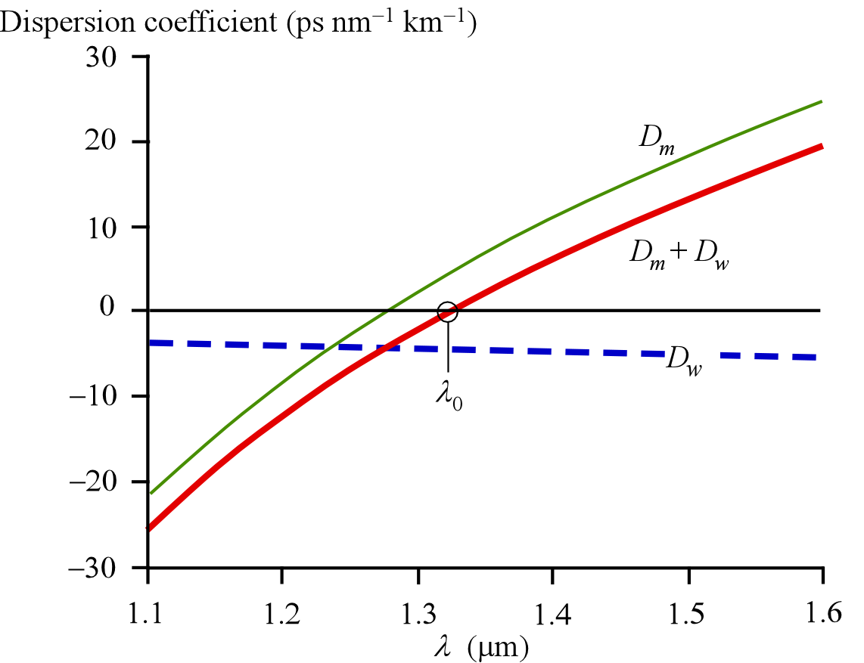
Chromatic Dispersion
Material dispersion coefficient (D_{m}) for the core material (taken as SiO₂), waveguide dispersion coefficient (D_{w}) (a = 4.2 μm) and the total or chromatic dispersion coefficient D_{ch} (= D_{m} + D_{w}) as a function of free space wavelength, λ
Chromatic = Material + Waveguide

Slide 77
What do Negative and Positive D_{m} mean?
Silica glass
Δτ
N_{g}
N_{g2} > N_{g1}
Negative D_{m}
1
Positive D_{m}
λ₁
v_{g1}
2
λ₂
v_{g2}
1
2
t
t
Positive D_{m}
Δτ = Positive
λ₁
λ₂
λ₁
λ₂
N_{g2} < N_{g1}
λ₁
v_{g1}
λ₂
v_{g2}
t
t
Negative D_{m}
Δτ = Negative
D_{m}
Δλ = λ₂ − λ₁

Slide 78
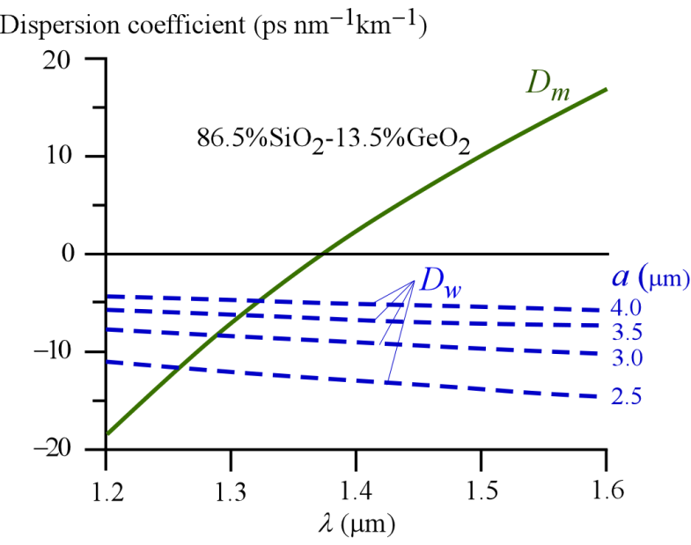
Waveguide Dimension and Chromatic Dispersion
Waveguide dispersion depends on the guide properties

Slide 79
Profile Dispersion
Group velocity v_{g}(01) of the fundamental mode depends on Δ, refractive index difference.
Δ may not be constant over a range of wavelengths: Δ = Δ(λ)
D_{p} = Profile dispersion coefficient
D_{p} < 0.1 ps nm⁻¹ km⁻¹
Can generally be ignored
NOTE
Total intramode (chromatic) dispersion coefficient D_{ch}
D_{ch} = D_{m} + D_{w} + D_{p}
where D_{m}, D_{w}, D_{p} are material, waveguide and profile dispersion coefficients respectively

Slide 80
Chromatic Dispersion
D_{ch} = D_{m} + D_{w} + D_{p}
Chromatic dispersion is zero at λ = λ₀
S₀ = Chromatic dispersion slope at λ₀

Slide 81

Is dispersion really zero at λ₀?
The cause of Δτ is the wavelength spread Δλ at the input
Δτ = f(Δλ)
= 0
Δλ for multimode laser diode

Slide 82
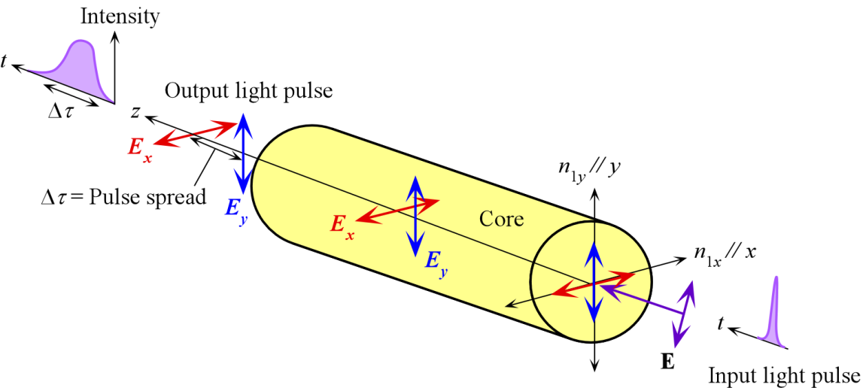
Polarization Dispersion
n different in different directions due to induced strains in fiber in manufacturing, handling and cabling. δn/n < 10⁻⁶
D_{PMD} = Polarization dispersion coefficient
Typically D_{PMD} = 0.1 − 0.5 ps km^{-1/2}

Slide 83
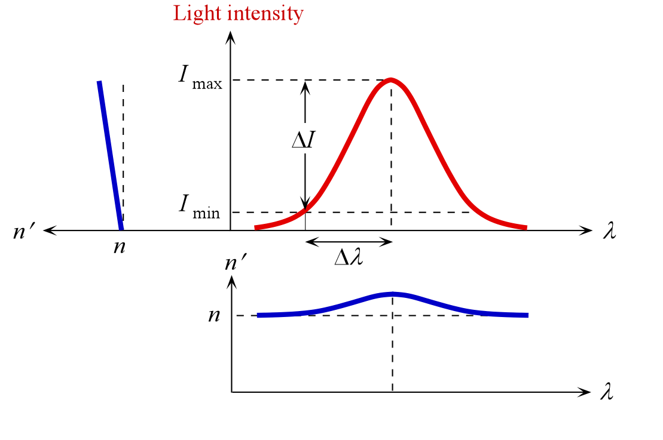
Self-Phase Modulation Dispersion : Nonlinear Effect
At sufficiently high light intensities, the refractive index of glass n′ is
n′ = n + CI
where C is a constant and I is the light intensity. The intensity of light modulates its own phase.
What is the optical power that will give Δτ/L ≈ 0.1 ps km⁻¹?
Take C = 10⁻¹⁴ cm² W⁻¹
∴ ΔI ≈ (c/C)(Δτ/L) = 3×10⁶ W cm⁻²
or Δn ≈ 3×10⁻⁶
Given 2a ≈ 10 μm, A ≈ 7.85×10⁻⁷ cm²
Optical power ≈ 2.35 W in the core
In many cases, this dispersion will be less than other dispersion mechanisms

Slide 84
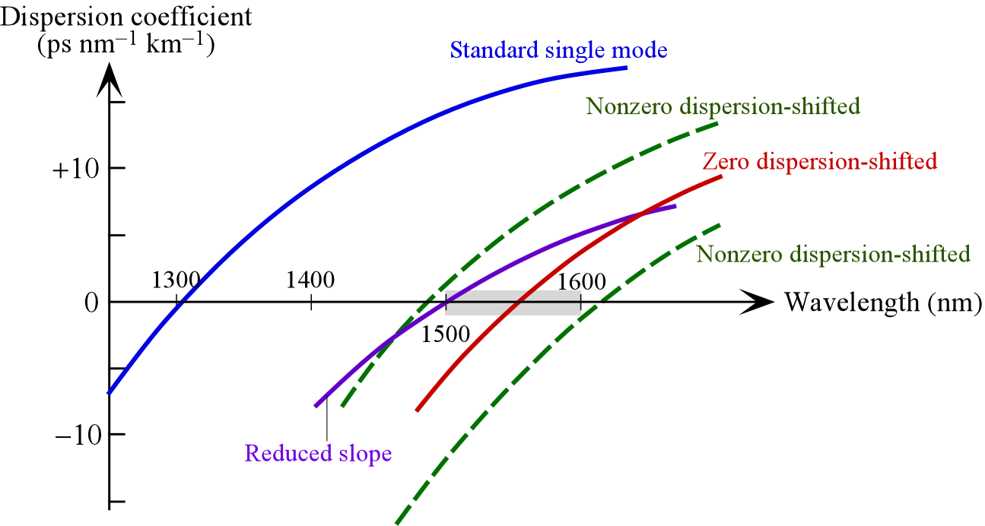
Nonzero Dispersion Shifted Fiber
For Wavelength Division Multiplexing (WDM) avoid 4 wave mixing: cross talk.
We need dispersion not zero but very small in Er-amplifer band (1525-1620 nm)
D_{ch} = 0.1 − 6 ps nm⁻¹ km⁻¹.
Nonzero dispersion shifted fibers
Various fibers named after their dispersion characteristics. The range 1500 - 1600 nm is only approximate and depends on the particular application of the fiber.

Slide 85
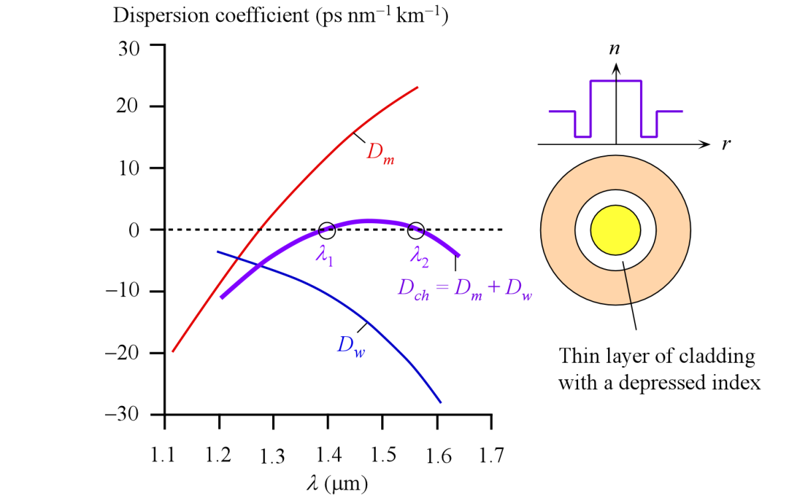
Dispersion Flattened Fiber
Dispersion flattened fiber example. The material dispersion coefficient (D_{m}) for the core material and waveguide dispersion coefficient (D_{w}) for the doubly clad fiber result in a flattened small chromatic dispersion between λ₁ and λ₂.

Slide 86
Nonzero Dispersion Shifted Fiber: More Examples
0.6%
0.4%
Nonzero dispersion shifted fiber (Corning)
Fiber with flattened dispersion slope (schematic)

Slide 87
Commercial Fibers for Optical Communications
Fiber | D_{ch} ps nm⁻¹ km⁻¹ | S₀ ps nm⁻² km⁻¹ | D_{PMD} ps km^{-1/2} | Some attributes
Standard single mode, ITU-T G.652 | 17 (1550 nm) | ≤ 0.093 | < 0.5 (cabled) | D_{ch} = 0 at λ₀ ≈ 1312 nm, MFD = 8.6 - 9.5 μm at 1310 nm. λ_{c} ≤1260 nm.
Non-zero dispersion shifted fiber, ITU-T G.655 | 0.1 − 6 (1530 nm) | < 0.05 at 1550 nm | < 0.5 (cabled) | For 1500 - 1600 nm range. WDM application MFD = 8 − 11 μm.
Non-zero dispersion shifted fiber, ITU-T G.656 | 2 − 14 | < 0.045 at 1550 nm | < 0.20 (cabled) | For 1460 - 1625 nm range. DWDM application. MFD = 7 − 11 μm (at 1550 nm). Positive D_{ch}. λ_{c} <1310 nm
Corning SMF28e+ (Standard SMF) | 18 (1550 nm) | 0.088 | < 0.1 | Satisfies G.652. λ₀ ≈ 1317 nm, MFD = 9.2 μm (at 1310 nm), 10.4 μm (at 1550 nm); λ_{c} ≤ 1260 nm.
OFS TrueWave RS Fiber | 2.6 - 8.9 | 0.045 | 0.02 | Satisfies G.655. Optimized for 1530 nm - 1625nm. MFD = 8.4 μm (at 1550 nm); λ_{c} ≤1260 nm.
OFS REACH Fiber | 5.5 -8.9 | 0.045 | 0.02 | Higher performance than G.655 specification. Satisfies G.656. For DWDM from 1460 to 1625 nm. λ₀ ≤ 1405 nm. MFD = 8.6 μm (at 1550 nm)

Slide 88
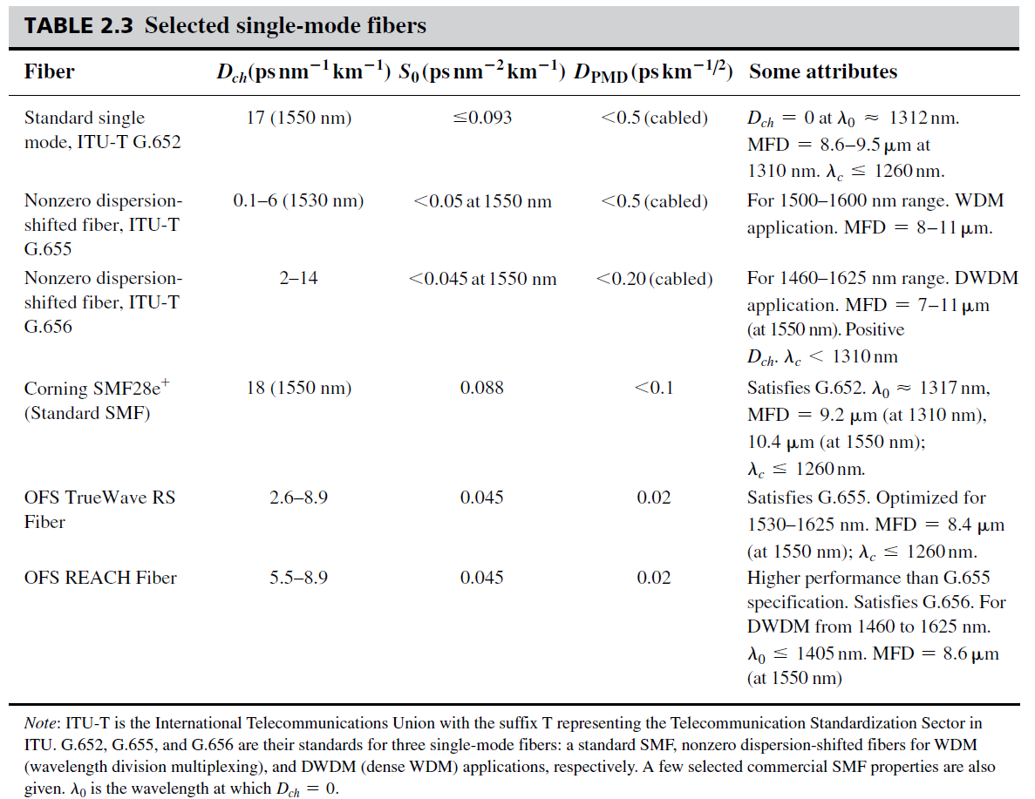
Single Mode Fibers: Selected Examples

Slide 89
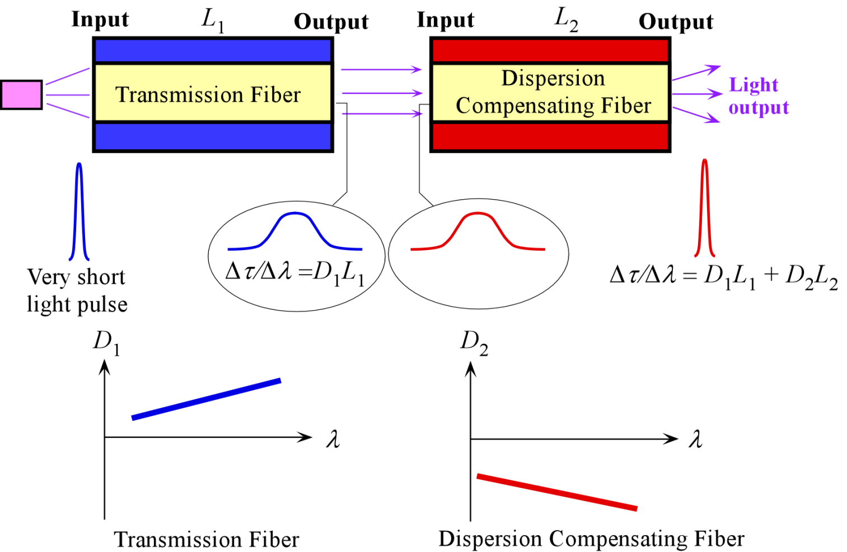
Dispersion Compensation
Total dispersion = D_{t}L_{t} + D_{c}L_{c} = (10 ps nm⁻¹ km⁻¹)(1000 km) +
(−100 ps nm⁻¹ km⁻¹)(80 km)
= 2000 ps/nm for 1080 km
D_{effective} = 1.9 ps nm⁻¹ km⁻¹

Slide 90
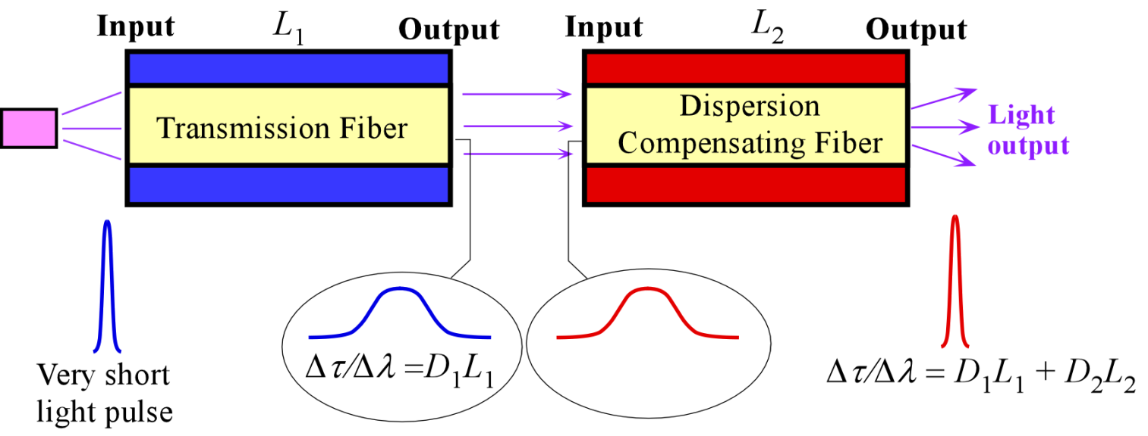
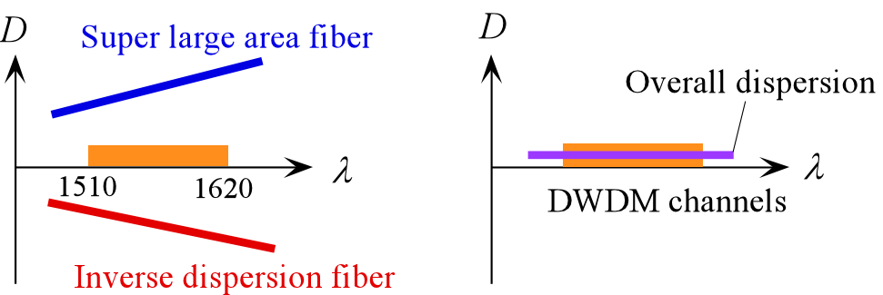
Dispersion Compensation
Dispersion D vs. wavelength characteristics involved in dispersion compensation. Inverse dispersion fiber enables the dispersion to be reduced and maintained flat over the communication wavelengths.

Slide 91
Dispersion Compensation and Management
Compensating fiber has higher attenuation. Doped core. Need shorter length
More susceptible to nonlinear effects. Use at the receiver end.
Different cross sections. Splicing/coupling losses.
Compensation depends on the temperature.
Manufacturers provide transmission fiber spliced to inverse dispersion fiber for a well defined D vs. λ

Slide 92
Dispersion and Maximum Bit Rate
Return-to-zero (RTZ) bit rate or data rate.
Nonreturn to zero (NRZ) bit rate = 2 RTZ bitrate

Slide 93
NRZ and RTZ

Slide 94
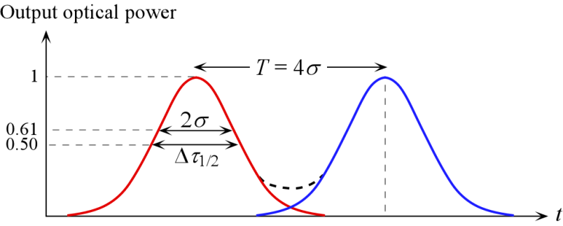
Maximum Bit Rate B
A Gaussian output light pulse and some tolerable intersymbol interference between two consecutive output light pulses (y-axis in relative units). At time t = σ from the pulse center, the relative magnitude is e^{−1/2} = 0.607 and full width root mean square (rms) spread is Δτ_{rms} = 2σ. (The RTZ case)

Slide 95
Dispersion and Maximum Bit Rate
Maximum Bit Rate
Dispersion
Bit Rate × Distance is
inversely proportional to dispersion
inversely proportional to line width of laser
(so, we need single frequency lasers!)

Slide 96
Dispersion and Maximum Bit Rate
Maximum Bit Rate

Slide 97
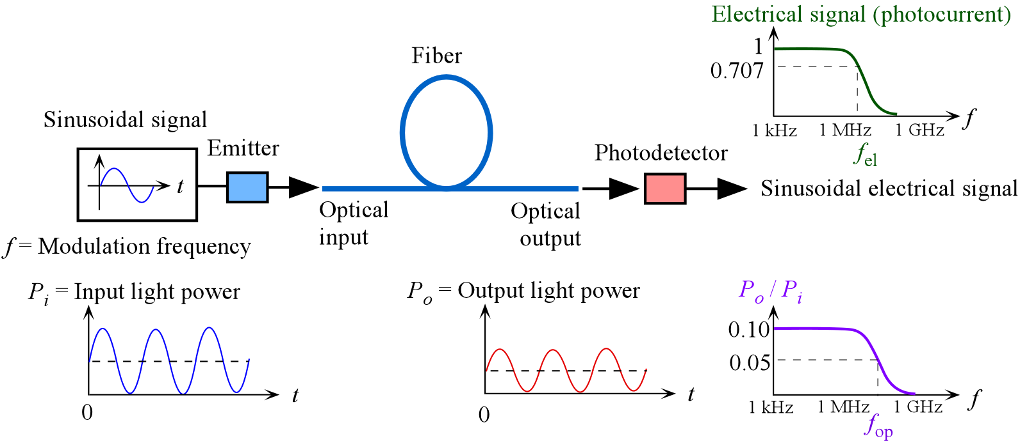
Optical Bandwidth
An optical fiber link for transmitting analog signals and the effect of dispersion in the fiber on the bandwidth, f_{op}.

Slide 98
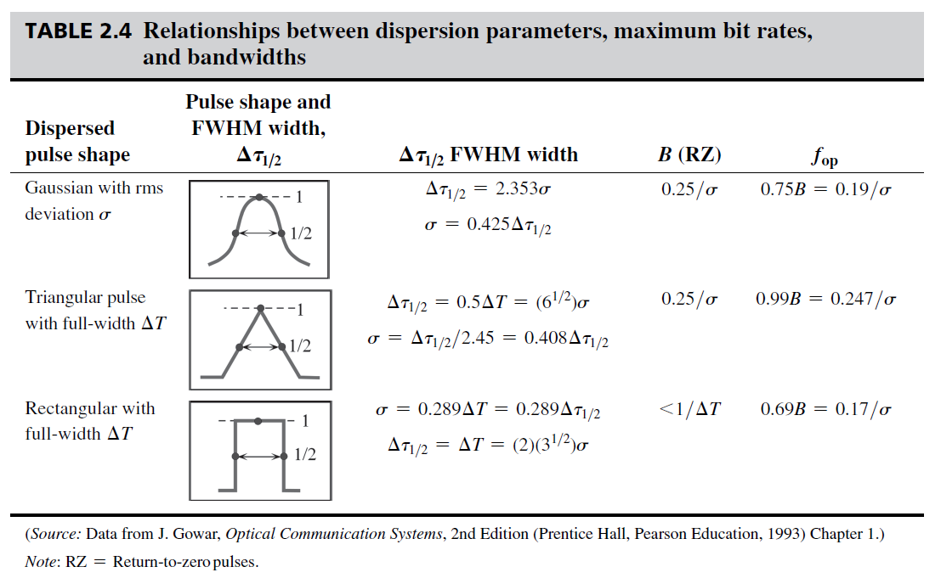
Pulse Shape and Maximum Bit Rate

Slide 99
Example: Bit rate and dispersion
Consider an optical fiber with a chromatic dispersion coefficient 8 ps km⁻¹ nm⁻¹ at an operating wavelength of 1.5 μm. Calculate the bit rate distance product (BL), and the optical and electrical bandwidths for a 10 km fiber if a laser diode source with a FWHP linewidth Δλ_{1/2} of 2 nm is used.
Solution
For FWHP dispersion,
Δτ_{1/2}/L = |D_{ch}|Δλ_{1/2} = (8 ps nm⁻¹ km⁻¹)(2 nm) = 16 ps km⁻¹
Assuming a Gaussian light pulse shape, the RTZ bit rate × distance product (BL) is
BL = 0.59L/Δτ_{1/2} = 0.59/(16 ps km⁻¹) = 36.9 Gb s⁻¹ km
The optical and electrical bandwidths for a 10 km fiber are
f_{op} = 0.75B = 0.75(36.9 Gb s⁻¹ km) / (10 km) = 2.8 GHz
f_{el} = 0.70f_{op} = 1.9 GHz

Slide 100

Graded Index (GRIN) Fiber
Multimode step index fiber. Ray paths are different so that rays arrive at different times.
Graded index fiber. Ray paths are different but so are the velocities along the paths so that all the rays arrive at the same time.

Slide 101

Graded Index (GRIN) Fiber
A ray in thinly stratifed medium becomes refracted as it passes from one layer to the next upper layer with lower n and eventually its angle satisfies TIR.
In a medium where n decreases continuously the path of the ray bends continuously.

Slide 102

Graded Index (GRIN) Fiber
The refractive index profile can generally be described by a power law with an index γ called the profile index (or the coefficient of index grating) so that,
n = n₁[1 − 2Δ(r/a)^{γ}]^{1/2} ; r < a,
n = n₂ ; r ≥ a
Minimum intermodal dispersion
Minimum intermodal dispersion

Slide 103
Graded Index (GRIN) Fiber
Minimum intermodal dispersion
Profile dispersion parameter
Minimum intermodal dispersion

Slide 104
Graded Index (GRIN) Fiber
Effective numerical aperture for GRIN fibers
Number of modes in a graded index fiber

Slide 105
Table 2.5
Graded index multimode fibers
d = core diameter (μm), D = cladding diameter (μm). Typical properties at 850 nm. VCSEL is a vertical cavity surface emitting laser. α is attenuation along the fiber. OM1, OM3 and OM4 are fiber standards for LAN data links (ethernet). α are reported typical attenuation values. 10G and 40G networks represent data rates of 10 Gb s⁻¹ and 40 Gb s⁻¹ and correspond to 10 GbE (Gigabit Ethernet) and 40 GbE systems.

Slide 106
Example: Dispersion in a GRIN Fiber and Bit Rate
Graded index fiber. Diameter of 50 μm and a refractive index of n₁ = 1.4750, Δ = 0.010.
The fiber is used in LANs at 850 nm with a vertical cavity surface emitting laser (VCSEL) that has very a narrow linewidth that is about 0.4 nm (FWHM). Assume that the chromatic dispersion at 850 nm is −100 ps nm⁻¹ km⁻¹ as shown in Table 2.5. Assume the fiber has been optimized at 850 nm, and find the minimum rms dispersion. How many modes are there? What would be the upper limit on its bandwidth? What would be the bandwidth in practice?
Solution
Given Δ and n₁, we can find n₂ from
Δ = 0.01 = (n₁ − n₂)/n₁ = (1.4750 − n₂)/1.4750.
n₂ = 1.4603.
The V-number is then
V = [(2π)(25 μm)/(0.850 μm)(1.4750²−1.4603²)^{1/2} = 38.39
For the number of modes we can simply take γ = 2 and use
M = (V²/4) = (38.39²/4) = 368 modes
The lowest intermodal dispersion for a profile optimized graded index fiber for a 1 km of fiber, L = 1 km, is

Slide 107
Example: Dispersion in a GRIN Fiber and Bit Rate
Solution continued
= 14.20×10⁻¹⁵ s m⁻¹ or 14.20 ps km⁻¹
Assuming a triangular output light pulse and the relationship between σ and Δτ_{1/2} given in Table 2.4, the intermodal spread Δτ_{intermode} (FWHM) in the group delay over 1 km is
Δτ_{intermode} = (6^{1/2})σ_{intermode} = (2.45)(14.20 ps) = 34.8 ps
We also need the material dispersion at the operating wavelength over 1 km, which makes up the intramodal dispersion Δτ_{intramode} (FWHM)
Δτ_{intramode} = L|D_{ch}| Δλ_{1/2} = (1 km)(−100 ps nm⁻¹ km⁻¹)(0.40 nm) = 40.0 ps
Δτ = 53.0 ps

Slide 108
Example: Dispersion in a GRIN Fiber and Bit Rate
Solution continued
= 11.5 Gb s⁻¹
Optical bandwidth f_{op} = 0.99B = 11.4 GHz
This is the upper limit since we assumed that the graded index fiber is perfectly optimized with σ_{intermode} being minimum. Small deviations around the optimum γ cause large increases in σ_{intermode}, which would sharply reduce the bandwidth.

Slide 109
Example: Dispersion in a GRIN Fiber and Bit Rate
Solution continued
If this were a multimode step-index fiber with the same n₁ and n₂, then the full dispersion (total spread) would roughly be
= 4.92×10⁻¹¹ s m⁻¹ or 49.2 ns km⁻¹
To calculate the BL we use σ_{intermode} ≈ 0.29Δτ
= 17.5 Mb s⁻¹ km
LANs now use graded index MMFs, and the step index MMFs are used mainly in low speed instrumentation

Slide 110
Example: Dispersion in a graded-index fiber and bit rate
Consider a graded index fiber whose core has a diameter of 50 μm and a refractive index of n₁ = 1.480. The cladding has n₂ = 1.460. If this fiber is used at 1.30 μm with a laser diode that has very a narrow linewidth what will be the bit rate × distance product? Evaluate the BL product if this were a multimode step index fiber.
Solution
The normalized refractive index difference Δ = (n₁ − n₂)/n₁ = (1.48 − 1.46)/1.48 = 0.0135. Dispersion for 1 km of fiber is
σ_{intermode}/L = n₁Δ²/[(20)(3^{1/2})c] = 2.6×10⁻¹⁴ s m⁻¹ or 0.026 ns km⁻¹.
BL = 0.25/σ_{intermode} = 9.6 Gb s⁻¹ km
We have ignored any material dispersion and, further, we assumed the index variation to perfectly follow the optimal profile which means that in practice BL will be worse. (For example, a 15% variation in γ from the optimal value can result in σ_{intermode} and hence BL that are more than 10 times worse.)
If this were a multimode step-index fiber with the same n₁ and n₂, then the full dispersion (total spread) would roughly be 6.67×10⁻¹¹ s m⁻¹ or 66.7 ns km⁻¹ and BL = 12.9 Mb s⁻¹ km
Note: Over long distances, the bit rate × distance product is not constant for multimode fibers and typically B ∝ L^{−γ} where γ is an index between 0.5 and 1. The reason is that, due to various fiber imperfections, there is mode mixing which reduces the extent of spreading.

Slide 111
Example: Combining intermodal and intramodal dispersions
Consider a graded index fiber with a core diameter of 30 μm and a refractive index of 1.474 at the center of the core and a cladding refractive index of 1.453. Suppose that we use a laser diode emitter with a spectral linewidth of 3 nm to transmit along this fiber at a wavelength of 1300 nm. Calculate, the total dispersion and estimate the bit-rate × distance product of the fiber. The material dispersion coefficient D_{m} at 1300 nm is −7.5 ps nm⁻¹ km⁻¹.
Solution
The normalized refractive index difference Δ = (n₁ − n₂)/n₁ = (1.474 − 1.453)/1.474 = 0.01425. Modal dispersion for 1 km is
σ_{intermode} = Ln₁Δ²/[(20)(3^{1/2})c] = 2.9×10⁻¹¹ s ¹ or 0.029 ns.
The material dispersion is
Δτ_{1/2} = LD_{m} Δλ_{1/2} = (1 km)(7.5 ps nm⁻¹ km⁻¹)(3 nm) = 0.0225 ns
Assuming a Gaussian output light pulse shape,
σ_{intramode} = 0.425Δτ_{1/2} = (0.425)(0.0225 ns) = 0.0096 ns
Total dispersion is
Assume L = 1 km
B = 0.25/Δτ_{rms} = 8.2 Gb

Slide 112

GRIN Rod Lenses
Point O is on the rod face center and the lens focuses the rays onto O' on to the center of the opposite face.
The rays from O on the rod face center are collimated out.
O is slightly away from the rod face and the rays are collimated out.
One pitch (P) is a full one period variation in the ray trajectory along the rod axis.

Slide 113

Attenuation
The attenuation of light in a medium
Attenuation = Absorption + Scattering
Attenuation coefficient α is defined as the fractional decrease in the optical power per unit distance. α is in m⁻¹.
P_{out} = P_{in}exp(−αL)

Slide 114

Attenuation in Optical Fibers
Attenuation vs. wavelength for a standard silica based fiber.

Slide 115

Lattice Absorption (Reststrahlen Absorption)
EM Wave oscillations are coupled to lattice vibrations (phonons), vibrations of the ions in the lattice. Energy is transferred from the EM wave to these lattice vibrations.
This corresponds to “Fundamental Infrared Absorption” in glasses

Slide 116

Rayleigh Scattering
Rayleigh scattering involves the polarization of a small dielectric particle or a region that is much smaller than the light wavelength. The field forces dipole oscillations in the particle (by polarizing it) which leads to the emission of EM waves in "many" directions so that a portion of the light energy is directed away from the incident beam.
β_{Τ} = isothermal compressibility (at T_{f})
T_{f} = fictive temperature (roughly the softening temperature of glass) where the liquid structure during the cooling of the fiber is frozen to become the glass structure

Slide 117
Example: Rayleigh scattering limit
What is the attenuation due to Rayleigh scattering at around the λ = 1.55 μm window given that pure silica (SiO₂) has the following properties: T_{f} = 1730°C (softening temperature); β_{T} = 7×10⁻¹¹ m² N⁻¹ (at high temperatures); n = 1.4446 at 1.5 μm.
Solution
We simply calculate the Rayleigh scattering attenuation using
α_{R} = 3.276×10⁻⁵ m⁻¹ or 3.276×10⁻² km⁻¹
Attenuation in dB per km is
α_{dB} = 4.34α_{R} = (4.34)(3.735×10⁻² km⁻¹) = 0.142 dB km⁻¹
This represents the lowest possible attenuation for a silica glass core fiber at 1.55 μm.

Slide 118
Attenuation in Optical Fibers
Attenuation vs. wavelength for a standard silica based fiber.

Slide 119

Low-water-peak fiber has no OH⁻ peak
E-band is available for communications with this fiber

Slide 120

Attenuation in Optical Fibers

Slide 121
Attenuation
A_{R} in dB km⁻¹ μm⁴
α_{R} in dB km⁻¹
λ in μm

Slide 122
Attenuation
Approximate attenuation coefficients for silica-based fibers for use in Equations (7) and (8). Square brackets represent concentration as a fraction. NA = Numerical Aperture. A_{R} = 0.59 used as reference for pure silica, and represents A_{R}(silica). Data mainly from K. Tsujikawa et al, Electron. Letts., 30, 351, 1994; Opt. Fib. Technol. 11, 319, 2005, H. Hughes, Telecommunications Cables (John Wiley and Sons, 1999, and references therein.)
Glass | A_{R} dB km⁻¹ μm⁴ | Comment | Glass
Silica fiber | 0.90 | "Rule of thumb" | Silica fiber
SiO₂-GeO₂ core step index fiber | 0.63 + 2.06×NA | NA depends on (n₁² – n₂²)^{1/2} and hence on the doping difference. | SiO₂-GeO₂ core step index fiber
SiO₂-GeO₂ core graded index fiber | 0.63 + 1.75×NA |  | SiO₂-GeO₂ core graded index fiber
Silica, SiO₂ | 0.63 | Measured on preforms. Depends on annealing. A_{R}(Silica) = 0.59 dB km⁻¹ μm⁴ for annealed. | Silica, SiO₂
65%SiO₂35%GeO₂ | 0.75 | On a preform. A_{R}/A_{R}(silica) = 1.19 | 65%SiO₂35%GeO₂
(SiO₂)_{1−x}(GeO₂)_{x} | A_{R(}silica)×(1 + 0.62x) | x = [GeO₂] = Concentration as a fraction (10% GeO₂, x = 0.1). For preform. | (SiO₂)_{1−x}(GeO₂)_{x}

Slide 123
Rayleigh Scattering
Example: Consider a single mode step index fiber, which has a numerical aperture of 0.14. Predict the expected attenuation at 1.55 μm, and compare your calculation with the reported (measured) value of 0.19 - 0.20 dB km⁻¹ for this fiber. Repeat the calculations at 1.31 µm, and compare your values with the reported 0.33 - 0.35 dB km⁻¹ values.
Solution
First, we should check the fundamental infrared absorption at 1550 nm.
= 0.020 dB km⁻¹, very small

Slide 124
Rayleigh Scattering
Solution
Rayleigh scattering at 1550 nm, the simplest equation with A_{R} = 0.9 dB km⁻¹ μm⁴, gives
α_{R} = A_{R}/λ⁴ = (0.90 dB km⁻¹ μm⁴)/(1.55 μm)⁴ = 0.178 dB km⁻¹
This equation is basically a rule of thumb. The total attenuation is then
α_{R} + α_{FIR} = 0.178 + 0.02 = 0.198 dB km⁻¹.
The current fiber has NA = 0.14.
∴ A_{R} = 0.63 + 2.06×NA = 0.63 + 2.06×0.14 = 0.918 dB km⁻¹ μm⁴
i.e. α_{R} = A_{R}/λ⁴ = (0.918 dB km⁻¹ μm⁴)/(1.55 μm)⁴ = 0.159 dB km⁻¹,
which gives a total attenuation of 0.159 + 0.020 or 0.179 dB km⁻¹.

Slide 125
Rayleigh Scattering
Solution
We can repeat the above calculations at λ = 1.31 μm. However, we do not need to add α_{FIR}.
α_{R} = A_{R}/λ⁴ = (0.90 dB km⁻¹ μm⁴)/(1.31 μm)⁴ = 0.306 dB km⁻¹
and using the NA based for A_{R},
α_{R} = A_{R}/λ⁴ = (0.918 dB km⁻¹ μm⁴)/(1.31 μm)⁴ = 0.312 dB km⁻¹.
Both close to the measured value.

Slide 126

Bending Loss
Definitions of (a) microbending and (b) macrobending loss and the definition of the radius of curvature, R. (A schematic illustration only.) The propagating mode in the fiber is shown as white painted area. Some radiation is lost in the region where the fiber is bent. D is the fiber diameter, including the cladding.

Slide 127
Bending Loss
Microbending loss
the radius of curvature R of the bend is sharp
bend radius is comparable to the diameter of the fiber
Typically microbending losses are significant when the radius of curvature of the bend is less than 0.1 − 1 mm.
They can arise from careless or poor cabling of the fiber or even in flaws in manufacturing that result in variations in the fiber geometry over small distances.

Slide 128
Bending Loss
Macrobending losses
Losses that arise when the bend is much larger than the fiber size
Typically much grater than 1 mm
Typically occur when the fiber is bent during the installation of a fiber optic link such as turning the fiber around a corner.
There is no simple precise and sharp boundary line between microbending and macrobending loss definitions.
Both losses essentially result from changes in the waveguide geometry and properties as the fiber is subjected to external forces that bend the fiber.
Typically, macrobending loss crosses over into microbending loss when the radius of curvature becomes less than a few millimeters.

Slide 129

Bending Loss
Sharp bends change the local waveguide geometry that can lead to waves escaping. The zigzagging ray suddenly finds itself with an incidence angle smaller than θ′ that gives rise to either a transmitted wave, or to a greater cladding penetration; the field reaches the outside medium and some light energy is lost.

Slide 130

Bending Loss
When a fiber is bent sharply, the propagating wavefront along the straight fiber cannot bend around and continue as a wavefront because a portion of it (black shaded) beyond the critical radial distance r_{c} must travel faster than the speed of light in vacuum. This portion is lost in the cladding- radiated away.

Slide 131

Bending Loss
(a) Bending loss in dB per turn of fiber for three types of fibers, standard single mode, and two trench fibers, around 1.55 - 1.65 μm. (b) The index profile for the trench fiber 1 in (a), and a schematic view of the fiber cross section. Experimental data have been used to generate the plots have been combined from various sources. (Standard fiber, M.-J. Li et al. J. Light Wave Technol., 27, 376, 2009; trench fiber 1, K. Himeno et al, J. Light Wave Technol., 23, 3494, 2005, trench fiber 2, L.-A. de Montmorillon, et al. “Bend-Optimized G.652D Compatible Trench-Assisted Single-Mode Fibers”, Proceedings of the 55th IWCS/Focus, pp. 342-347, November, 2006.)

Slide 132


Bend Insensitive Fibers
Left, the basic structure of bend insensitive fiber with a nanoengineered ring in the cladding. Right, an SEM picture of the cross section of a nanoengineered fiber with reduced bending losses. (Courtesy of Ming-Jun Li, Corning Inc. For more information see US Patent 8,055.110, 2011)

Slide 133
Bending Loss in Fibers General Description
α_{B} = Aexp(−R/R_{c})
A and R_{c} are constants

Slide 134

Bending Loss
α_{B} = Aexp(−R/R_{c})
where A and R_{c} are constants
For single mode fibers, a quantity called a MAC-value, or a MAC-number, N_{MAC}, has been used to characterize the bending loss. N_{MAC} is defined by

Slide 135

Microbending Loss
Measured microbending loss for a 10 cm fiber bent by different amounts of radius of curvature R. Single mode fiber with a core diameter of 3.9 μm, cladding radius 48 μm, Δ = 0.00275, NA ≈ 0.10, V ≈ 1.67 and 2.08. Data extracted from A.J. Harris and P.F. Castle, "Bend Loss Measurements on High Aperture Single-Mode Fibers as a Function of Wavelength and Bend Radius", IEEE J. Light Wave Technology, Vol. LT14, 34, 1986, and repotted with a smoothed curve; see original article for the discussion of peaks in α_{B} vs. R at 790 nm).

Slide 136
Bending Loss in SMF
α_{B} = Aexp(−R/R_{c})
MAC-value, or a MAC-number, N_{MAC}
NOTES
α_{B} increases with increasing MFD
α_{B} decreasing cut-off wavelength.
α_{B} increases exponentially with the MAC-number
It is not a universal function, and different types of fibers, with very different refractive index profiles, can exhibit different α_{B}−N_{MAC} behavior.
N_{MAC} values are typically in the range 6 − 8

Slide 137
Standard Fibers and Bending Loss
α_{B} = Aexp(−R/R_{c})
OM1 MMF for use at 850 and 1310
OM1
“Maximum bending (macrobending) loss of 0.5 dB when the fiber is wound 100 turns with a radius 75 mm i.e. a bending loss of 0.005 dB/turn for a bend radius of 75 mm.”
Bend insensitive fibers have been designed to have lower bend losses. For example, some fiber manufacturers specify the allowed bend radius for a given level of attenuation at a certain wavelength (e.g. 1310 nm)

Slide 138
Bending Loss Example
Example: Experiments on a standard SMF operating around 1550 nm have shown that the bending loss is 0.124 dB/turn when the bend radius is 12.5 mm and 15.0 dB/turn when the bend radius is 5.0 mm. What is the loss at a bend radius of 10 mm?
Solution
Apply
α_{B} = Aexp(−R/R_{c})
0.124 dB/turn = Aexp[−(12.5 mm)/R_{c}]
15.0 dB/turn = Aexp[−(5.0 mm)/R_{c}]
Solve for A and R_{c}. Dividing the first by the second and separating out R_{c} we find,
R_{c} = (12.5 mm − 5.0 mm) / ln(15.0/0.124) = 1.56 mm
and A = (15.0 dB/turn) exp[(5.0 mm)/(1.56 mm] = 370 dB/turn
At R = 10 mm
α_{B} = Aexp(−R/R_{c}) = (370)exp[−(10 mm)/(1.56 mm)]
= 0.61 dB/turn.
The experimental value is also 0.61 dB/turn to within two decimals.

Slide 139
Example: Microbending loss It is found that for a single mode fiber with a cut-off wavelength λ_{c} = 1180 nm, operating at 1300 nm, the microbending loss reaches 1 dB m⁻¹ when the radius of curvature of the bend is roughly 6 mm for Δ = 0.00825, 12 mm for Δ = 0.00550 and 35 mm for Δ = 0.00275. Explain these findings.
Solution:
Given α = α₁, R increases from R₁ to R₂ when V decreases from V₁ to V₂.
Expected R ↑ with V↓
Equivalently at one R = R₁, α ↑ with V↓
We can generalize by noting that the penetration depth into the cladding δ ∝ 1/V.
Expected R ↑ with δ↑
Equivalently at one R = R₁, α ↑ with δ↑
Thus, microbending loss α gets worse when penetration δ into cladding increases; intuitively correct. Experiments show that for a given α = α₁, R increases with decreasing Δ. We know from basic optics δ↑ with Δ↓ i.e.δ increases with decreasing Δ.
Thus expected R ↑ with δ↑ with Δ↓ as observed

Slide 140
Example: Microbending loss It is found that for a single mode fiber with a cut-off wavelength λ_{c} = 1180 nm, operating at 1300 nm, the microbending loss reaches 1 dB m⁻¹ when the radius of curvature of the bend is roughly 6 mm for Δ = 0.00825, 12 mm for Δ = 0.00550 and 35 mm for Δ = 0.00275. Explain these findings.
Solution:
R_{c} is a constant (“a critical radius type of constant”) that is proportional to Δ^{−3/2}. Taking logs,
lnα = −Δ^{3/2}R + constant
We are interested in the Δ vs R behavior at a constant α. We can lump the constant into lnα and obtain,
∝ R^{-2/3}
The plot in the figure gives an index close this value.

Slide 141

Manufacture of Optical Fibers

Slide 142

Typical Cross Section of an Optical Fiber
The cross section of a typical single-mode fiber with a tight buffer tube. (d = diameter)

Slide 143
Outside vapor Deposition (OVD)
Main reactions are
Silicon tetrachloride and oxygen produces silica
SiCl₄(gas) + O₂(gas) → SiO₂(solid) + 2Cl₂(gas)
Germanium tetrachloride and oxygen produces germania
GeCl₄(gas) + O₂(gas) → GeO₂(solid) + 2Cl₂(gas)

Slide 144

Donald Keck, Bob Maurer and Peter Schultz (left to right) at Corning shortly after announcing the first low loss optical fibers made in 1970. Keck, Maurer and Schultz developed the outside vapor deposition (OVD) method for the fabrication of preforms that are used in drawing fibers with low losses. Their OVD was based on Franklin Hyde’s vapor deposition process earlier at Corning in 1930s. OVD is still used today at Corning in manufacturing low loss fibers. (Courtesy of Corning)

Slide 145

Peter Schultz making a germania-doped multimode fiber preform using the outside vapor deposition (OVD) process circa 1972 at Corning. Soot is deposited layer by layer on a thin bait rod rotating and translating in front of the flame hydrolysis burner. The first fibers made by the OVD at that time had an attenuation of 4 dB/km, which was among the lowest, and below what Charles Kao thought was needed for optical fiber communications, 20 dB/km (Courtesy of Peter Schultz.)

Slide 146

Outside Vapor Deposition (OVD)
Schematic illustration of OVD and the preform preparation for fiber drawing. (a) Reaction of gases in the burner flame produces glass soot that deposits on to the outside surface of the mandrel. (b) The mandrel is removed and the hollow porous soot preform is consolidated; the soot particles are sintered, fused, together to form a clear glass rod. (c) The consolidated glass rod is used as a preform in fiber drawing.

Slide 147

WAVELENGTH DIVISION MULTIPLEXING: WDM

Slide 148
WAVELENGTH DIVISION MULTIPLEXING: WDM
Generation of different wavelengths of light each with a narrow spectrum to avoid any overlap in wavelengths.
Modulation of light without wavelength distortion; i.e. without chirping (variation in the frequency of light due to modulation).
Efficient coupling of different wavelengths into a single transmission medium.
Optical amplification of all the wavelengths by an amount that compensates for attenuation in the transmission medium, which depends on the wavelength.
Dropping and adding channels when necessary during transmission.
Demultiplexing the wavelengths into individual channels at the receiving end.
Detecting the signal in each channel. To achieve an acceptable bandwidth, we need to dispersion manage the fiber (use dispersion compensation fibers), and to reduce cross-talk and unwanted signals, we have to use optical filters to block or pass the required wavelengths. We need various optical components to connect the devices together and implement the whole system.

Slide 149
WAVELENGTH DIVISION MULTIPLEXING: WDM
If Δυ < 200 GHz then WDM is called dense wavelength division multiplexing and denoted as DWDM.
At present, DWDM stands typically at 100 GHz separated channels which is equivalent to a wavelength separation of 0.8 nm.
DWDM imposes stringent requirements on lasers and modulators used for generating the optical signals.
It is not possible to tolerate even slight shifts in the optical signal frequency when channels are spaced closely. As the channel spacing becomes narrower as in DWDM, one also encounters various other problems not previously present. For example, any nonlinearity in a component carrying the channels can produce intermodulation between the channels; an undesirable effect. Thus, the total optical power must be kept below the onset of nonlinearity in the fiber and optical amplifiers within the WDM system.

Slide 150
Nonlinear Effects and DWDM
Induced Polarization, P = a₁E + a₂E² + a₃E³
Nonlinear effects
Nonlinear behavior for glasses
P = a₁E + a₃E³
Four photon mixing
Consider signals at 3 channels
E₁ = C₁cos(2πυ₁t) E₂ = C₂cos(2πυ₂t) E₃ = C₃cos(2πυ₃t)
Nonlinear P = a₃E³ = a₃(E₁ + E₂ + E₃)³
= a₃(E₁³) + …+ 2a₃(E₁E₂E₃) +...+ a₃(E₃³)

Slide 151
Nonlinear Effects and DWDM
Nonlinear P = a₃(E₁³) +…+ 2a₃(E₁E₂E₃) +...+ a₃(E₃³)
Nonlinear P = …+ 2a₃C₁C₂C₃cos(2πυ₁t)cos(2πυ₂t)cos(2πυ₃t) +…
Frequencies mix and can be written as sum and difference frequencies
Consider three optical signals at
υ₁
υ₂ = (υ₁ + 100 GHz )
υ₃ = (υ₂ + 100 GHz ) = (υ₁ + 200 GHz)

Slide 152

Nonlinear Effects and DWDM Four Photon (Wave) Mixing
Three photons (υ₁, υ₂, υ₃ ) mix to generate a fourth photon (υ₄ )
υ₄ = υ₁ + υ₂ − υ₃
υ₄ = υ₁ + ( υ₁ + 100 GHz ) − (υ₁ + 200 GHz)
υ₄ = υ₁ − 100 GHz on top of previous channel

Slide 153
Nonlinear Effects: Frequency Chirping
n = n_{o} + n₂I
Nonlinear refractive index
Self-phase modulation
Frequency chirping

Slide 154

Nonlinear Effects: Frequency Chirping
n = n_{o} + n₂I
Self-phase modulation
Frequency chirping

Slide 155

Stimulated Brillouin Scattering
(a) Scattering of a forward travelling EM wave A by an acoustic wave results in a reflected, backscattered, wave B that has a slightly different frequency, by Ω. (b) The forward and reflected waves, A and B respectively, interfere to give rise to a standing wave that propagates at the acoustic velocity v_{a}. As a result of electrostriction, an acoustic wave is generated that reinforces the original acoustic wave and stimulates further scattering.

Slide 156
Stimulated Brillouin Scattering (SBS)
Atomic vibrations give rise to traveling waves in the bulk − phonons. Collective vibrations of the atoms in a solid give rise to lattice waves inside the solid
Acoustic lattice waves in a solid involve periodic strain variations along the direction of propagation.
Changes in the strain result in changes in the refractive index through a phenomenon called the photoelastic effect. (The refractive index depends on strain.) Thus, there is a periodic variation in the refractive index which moves with an acoustic velocity v_{a} as depicted
The moving diffraction grating reflects back some of the forward propagating EM wave A to give rise to a back scattered wave B as shown. The frequency ω_{B} of the back scattered wave B is Doppler shifted from that of the forward wave ω_{A} by the frequency Ω of the acoustic wave i.e. ω_{B} = ω_{A} − Ω.

Slide 157
Stimulated Brillouin Scattering (SBS)
The forward wave A and the back scattered wave B interfere and give rise to a standing wave C.
This standing wave C represents a periodic variation in the field that moves with a velocity v_{a} along the direction of the original acoustic wave
The field variation in C produces a periodic displacement of the atoms in the medium, through a phenomenon called electrostriction. (The application of an electric field causes a substance to change shape, i.e. experience strain.). Therefore, a periodic variation in strain develops, which moves at the acoustic velocity v_{a}.
The moving strain variation is really an acoustic wave, which reinforces the original acoustic wave and stimulates more back scattering. Thus, it is clear that, a condition can be easily reached that Brillouin scattering stimulates further scattering; stimulated Brillouin scattering (SBS).

Slide 158
Stimulated Brillouin Scattering (SBS)
The SBS effect increases as the input light power increase
The SBS effect increases as the spectral width of the input light becomes narrower.
The onset of SBS depends not only on the fiber type and core diameter, but also on the spectral width Δλ of the laser output spectrum.
SBS is enhanced as the laser spectral width Δλ is narrowed or the duration of light pulse is lengthened.
Typical values: For a directly modulated laser diode emitting at 1550 nm into a single mode fiber, the onset of SBS is expected to occur at power levels greater than 20 − 30 mW. In DWDM systems with externally modulated lasers, i.e. narrower Δλ, the onset of SBS can be as low as ~10 mW. SBS is an important limiting factor in transmitting high power signals in WDM systems.

Slide 159

Bragg Fibers
Corrected
Bragg fibers have a core region surrounded by a cladding that is made up of concentrating layers of high low refractive index dielectric media
The core can be a low refractive index solid material or simply hollow. In the latter case, we have a hollow Bragg fiber.
The high (n₁) and low (n₂) alternating refractive index profile constitutes a Bragg grating which acts as a dielectric mirror.
There is a band of wavelengths, forming a stop-band, that are not allowed to propagate into the Bragg grating.
We can also view the periodic variation in n as forming a photonic crystal cladding in one-dimension, along the radial direction, with a stop-band, i.e. a photonic bandgap.
Light is bound within the core of the guide for wavelengths within this stop-band. Light can only propagate along z. The cladding is like a dielectric mirror
d₁ = λ/4n₁ and d₂ = λ/4n₂
∴
d₁n₁ = d₂n₂

Slide 160

Bragg Fibers
Bragg reflections from the cladding need
2 × (kn₁d₁ + kn₂d₂) = m(2π)
Integer
Behaves like a dielectric mirror
∴
(2π/λ)2(n₁d₁ + n₂d₂) = m(2π)
∴
n₁d₁ + n₂d₂ = m(λ/2)
This is satisfied for d₁ = λ/4n₁ and d₂ = λ/4n₂
Layers are quarter wavelength thick
d₁n₁ = d₂n₂

Slide 161
Bragg Fibers
(a) A Bragg fiber and its cross section. The Bragg grating in the cladding can be viewed to reflect the waves back into the core over its stop-band. (b) The refractive index variation (exaggerated). (c) Typical field distribution for the circumferential field E_{θ}.

Slide 162

Photonic Crystal Fibers: Holey Fibers
(a) A solid core PCF. Light is index guided. The cladding has a hexagonal array of holes. d is the hole diameter and Λ is the array pitch, spacing between the holes (b) and (c) A hollow core PCF. Light is photonic bandgap (PBG) guided.

Slide 163



Photonic Crystal Fibers: Holey Fibers
Left: The first solid core photonic crystal fiber prepared by Philip Russell and coworkers at the University of Bath in 1996; an endlessly single mode fiber. (Courtesy of Philip Russell)
Above: A commercially available hollow core photonic crystal fiber from Blaze Photonics. (Courtesy of Philip Russell)
Left: One of the first hollow core photonic crystal fibers, guiding light by the photonic bandgap effect (1998) (Courtesy of Philip Russell)

Slide 164

Photonic Crystal Fibers: Holey Fibers
Philip Russell (center), currently at the Max Planck Institute for the Science of Light in Erlangen, Germany, led the team of two postdoctoral research fellows, Jonathan Knight (left) and Tim Birks (right) (both currently professors at the University of Bath in England) that carried out the initial pioneering research on photonic crystal fibers in the 1990s. (See reviews by P.St.J. Russell, Science, 299, 358, 2003, J. C. Knight, Nature, 424, 847, 2003) (Courtesy of Philip Russell)

Slide 165

Solid Core Photonic Crystal Fibers
Both the core and cladding use the same material, usually silica, but the air holes in the cladding result in an effective refractive index that is lower than the solid core region.
The cladding has a lower effective refractive index than the core, and the whole structure then is like a step index fiber.
Total internal reflection then allows the light to be propagated just as in a step index standard silica fiber. Light is index guided.

Slide 166

Solid Core Photonic Crystal Fibers
(a) The fundamental mode is confined. (b) Higher modes have more nodes and can leak away through the space.
The solid can be pure silica, rather than germania-doped silica, and hence exhibits lower scattering loss.
Single mode propagation can occur over a very large range of wavelengths, almost as if the fiber is endlessly single mode (ESM). The reason is that the PC in the cladding acts as a filter in the transverse direction, which allows the higher modes to escape (leak out) but not the fundamental mode.

Slide 167
Solid Core Photonic Crystal Fibers
(a) The fundamental mode is confined. (b) Higher modes have more nodes and can leak away through the space.
ESM operation: The core of a PCF can be made quite large without losing the single mode operation. The refractive index difference can also be made large by having holes in the cladding. Consequently, PCFs can have high numerical apertures and large core areas; thus, more light can be launched into a PCF. Further, the manipulation of the shape and size of the hole, and the type of lattice (and hence the periodicity i.e. the lattice pitch) leads to a much greater control of chromatic dispersion.

Slide 168

Hollow Core Photonic Crystal Fibers: Holey Fibers
Notice that the core has a lower refractive index (it is hollow) so that we cannot rely on total internal reflection (TIR) to explain light propagation.
Light in the transverse direction is reflected back into the core over frequencies within the stop-band, i.e. photonic bandgap (PBG), of the photonic crystal in the cladding. When light is launched from one end of the fiber, it cannot enter the cladding (its frequency is within the stop-band) and is therefore confined within the hollow core. Light is photonic bandgap guided.

Slide 169

Hollow Core Photonic Crystal Fibers: Holey Fibers
As recalled by Philip Russell:
"My idea, then, was to trap light in a hollow core by means of a 2D photonic crystal of microscopic air capillaries running along the entire length of a glass fiber. Appropriately designed, this array would support a PBG for incidence from air, preventing the escape of light from a hollow core into the photonic-crystal cladding and avoiding the need for TIR." (P. St.J. Russell, J. Light Wave Technol, 24, 4729, 2006)
The periodic arrangement of the air holes in the cladding creates a photonic bandgap in the transverse direction that confines the light to the hollow core.

Slide 170
Hollow Core Photonic Crystal Fibers: Holey Fibers
There are certain distinct advantages
Material dispersion is absent.
The attenuation in principle should be potentially very small since there is no Rayleigh scattering in the core. However, scattering from irregularities in the air-cladding interface, that is, surface roughness, seems to limit the attenuation.
High powers of light can be launched without having nonlinear effects such as stimulated Brillouin scattering limiting the propagation.
There are other distinct advantages that are related to strong nonlinear effects, which are associated with the photonic crystal cladding.

Slide 171


Fiber Bragg Gratings and FBG Sensors
Fiber Bragg Grating (FBG) based optical strain sensor for monitoring strains in civil structures e.g. bridges, dams, buildings, tunnels and building. The fiber is mounted on a steel carrier and maintained stretched. The carriage is welded to the steel structure. (Courtesy of Micron Optics)
Fiber Bragg Grating (FBG) based optical temperature sensors for use from -200 °C to 250 °C. FBGs are mounted in different packages: top, left, all dielectric, top right, stainless steel and bottom, copper. The sensors operate over 1510 - 1590 nm. (Courtesy of Lake Shore Cryotronics Inc.)

Slide 172
FBG: Fiber Bragg Grating
Fiber Bragg grating has a Bragg grating written in the core of a single mode fiber over a certain length of the fiber. The Bragg grating reflects any light that has the Bragg wavelength λ_{B}, which depends on the refractive index and the periodicity. The transmitted spectrum has the Bragg wavelength missing.

Slide 173
Fiber Bragg Grating: FBG
Variation in n in the grating acts like a dielectric mirror
Partial Fresnel reflections from the changes in the refractive index add in phase and give rise to a back reflected (back diffracted) wave only at a certain wavelength λ_{B}, called the Bragg wavelength
Integer, 1,2,… normally q = 1 is used, the fundamental

Slide 174
Bragg Wavelength λ_{B}
A and B are reflected waves
A
B
Λ
Repeat unit = unit cell
For reflection A and B must be in phase i.e. phase difference should be q2π. This will be so at wavelength λ_{B}, the Bragg wavelength. The phase difference between A and B is ΔΦ_{AB}
Average index in unit cell

Slide 175

Fiber Bragg Grating: FBG
Reflectance, R
κL < 1 Weak
kL > 1 Strong

Slide 176
FBG Sensors
Strain
Photoelastic or elasto-optic coefficient

Slide 177
FBG Sensors
Consider strain which results in changes in n and Λ

Slide 178

FBG Sensors
A highly simplified schematic diagram of a multiplexed Bragg grating based sensing system. The FBG sensors are distributed on a single fiber that is embedded in the structure in which strains are to be monitored. The coupler allows optical power to be coupled from one fiber to the other.

Slide 179
FBG at 1550 nm
EXAMPLE
A silica fiber based FBG is required to operate at 1550 nm. What should be the periodicity of the grating Λ? If the amplitude of index variation Δn is 10⁻⁴ and total length of the FBG is 10 mm, what is the reflectance at the Bragg wavelength and the spectral width of the reflected light? Assume that the effective refractive index is 1.4550
SOLUTION
We can use
1550 nm = 2(1.450)(Λ) so that the grating periodicity Λ = 534.5 nm
The coupling coefficient κ is by
κ = πΔn/λ = π(10⁻⁴)/(1550×10⁻⁹ m) = 202.7 m⁻¹.
Thus, κL = 2.027, so the FBG is a strong grating. The reflectance is
= tanh²(2.027) = 0.933 or 93.3%
= 0.428 nm
The reflectance and spectral width values are approximate inasmuch as above equations contain a number of assumptions.

Slide 180
Appendix I: FBG Strain Gauge
Some researchers use
or
∴
and
Compare with (2.15.7)
What is the difference?

Slide 181
Appendix I
compare with
For silica glass, take n ≈ 1.44
∴

Slide 182
Updates and
Corrected Slides
Class Demonstrations
Class Problems
Check author’s website
http://optoelectronics.usask.ca
Email errors and corrections to safa.kasap@yahoo.com

